Slide 1
Sugon 8-way Server
—I980-G10

Slide 2
Contents
1
An overview of I980-G10 server
2
Introduce every module of I980-G10 server
3
Introduce management module of I980-G10 server
4
Structure and installation of I980-G10 server
Notes:
先讲整个IT行业的大背景

Slide 3
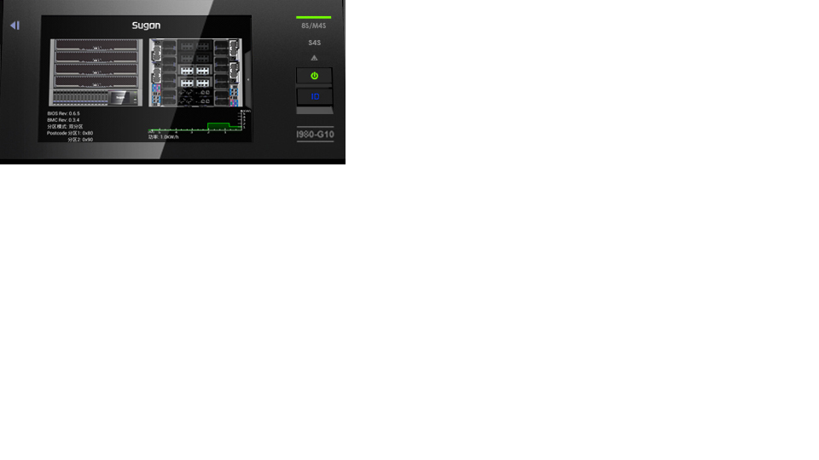
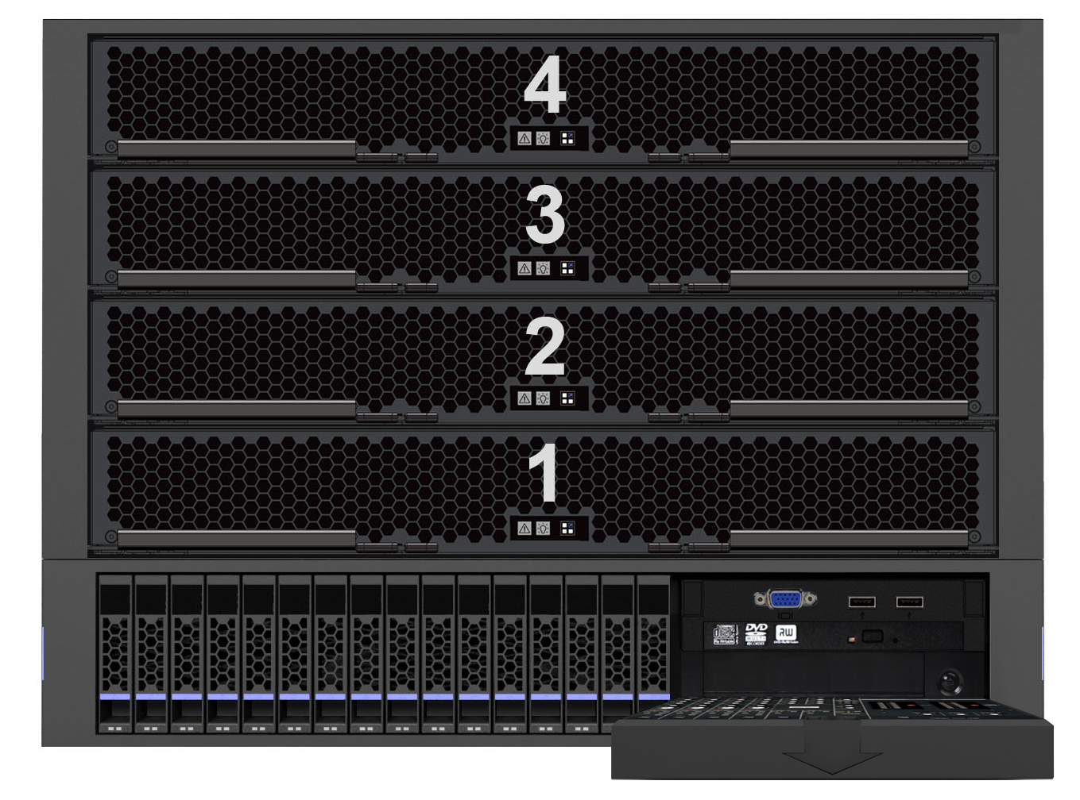
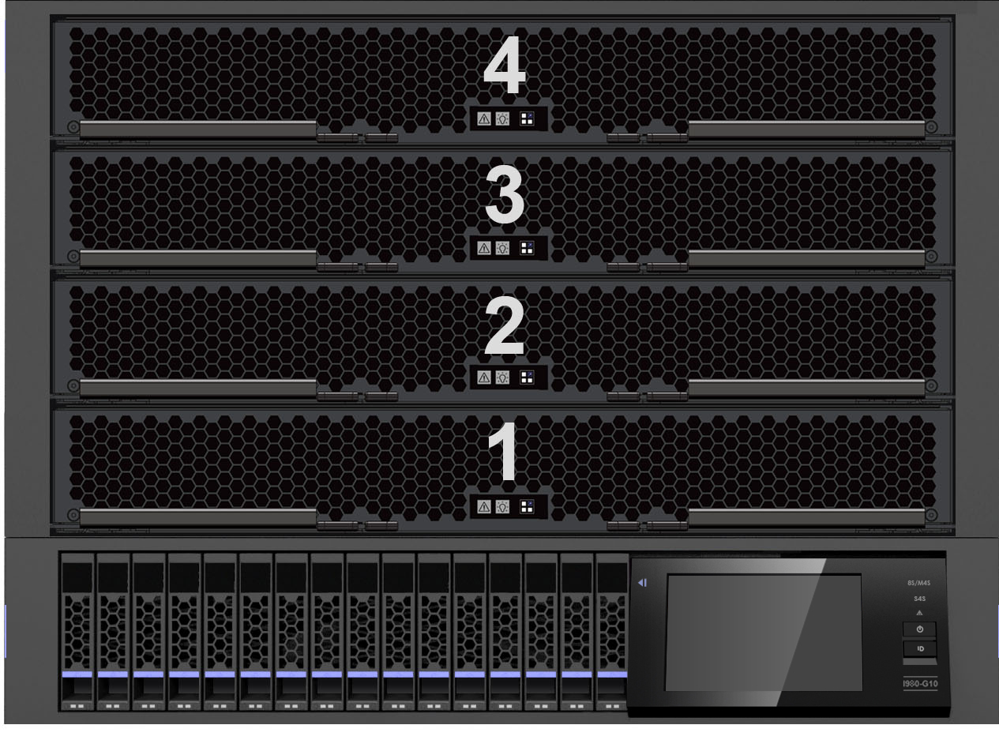
I980-G10 Front Panel
Board module
[1、3] for a group
[2、4] for a group
VGA interface
USB interface
DVD drive
tape machine(optional）
Disk module(max) :16 2.5’diskc
Touch Screen Monitoring
Notes:
先讲整个IT行业的大背景

Slide 4
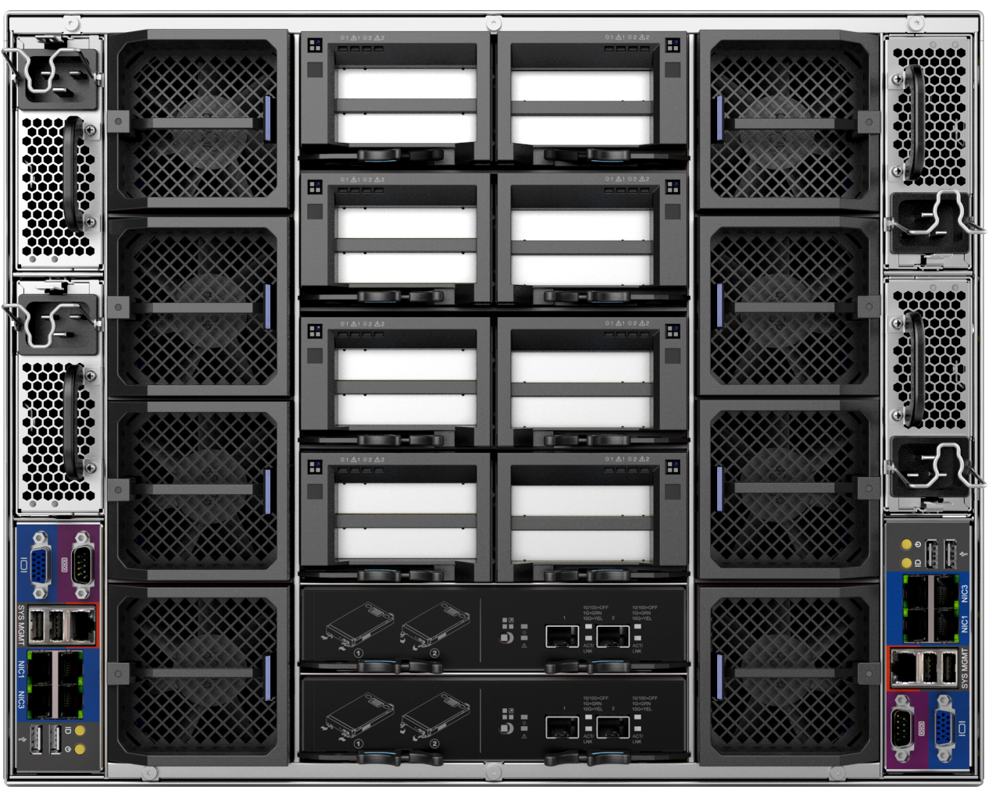
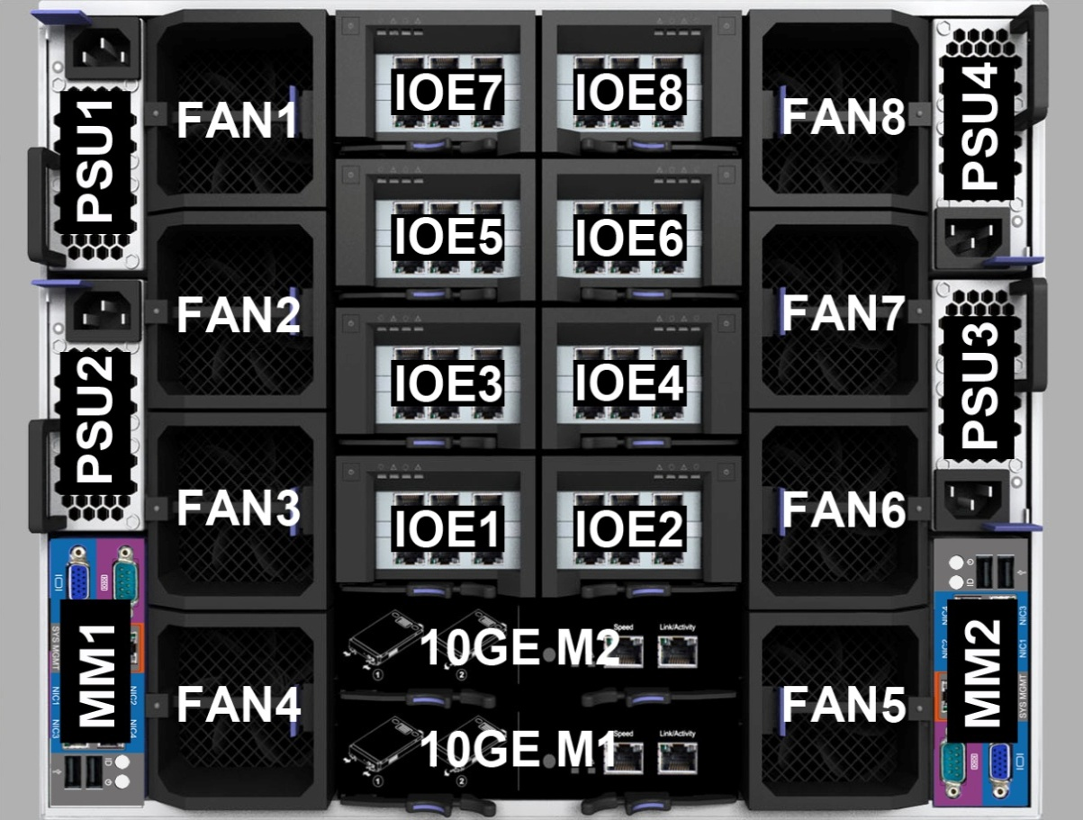
I980-G10 Back Panel
Hot-swappable IOE Module；
Support 16* X8 /4* X16 PCI-E Cards，
Support GPU；
Power Module:
4* 2000W(max)；
2+1, 3+1, 2+2 Redundant Mode
Up to 8 hot swap redundant fans
4* USB 2.0
Management
VGA Serial Port, 4* GbE/hundred Mbps interface
4个USB interface
Dual ports 10 GbE SFP
Optional number:0/1/2
Notes:
先讲整个IT行业的大背景

Slide 5
Partitioning module introduction of I980-G10
Single partition
Dual partition
Definition
Definition
1、Single 8-way system needs 4 mainboard modules
2、Single 4-way system needs 2 mainboard module
4 mainboard modules are installed , and two of them form a 4-way server system. Thus, there are 2 4-way severs: main 4-way and subordinate 4-way.
Characteristics
1、IOE module of single 8-way has priority on IOE 2、4、5、6
IOE module of single 4-way has priority on IOE1、2、5、6
2、Storage shared system can support 16 hard disks(max)
3、Management module only needs one MM1 and the other one if installed doesn’t has redundant function
4、8-way can share 20-gigabit module;4-way only can choose 10-gigabit module
5、Power supply module and fan module can be shared in the whole system
Characteristics
1、Main 4- way use compute module 1 and 3; subordinate 4-way use compute module 2 and 4
2、Main 4- way use IOE1、2、5、6; subordinate 4-way use IOE3,4,7,8.
3、storage system is partitioned:installed SAS/SAS RAID cards belong to two 4-way system and each of them supports up to 8 disks
4、2 management modules need to be installed : MM1 is used for main 4-way and MM2 is used for subordinate 4-way
5、10-gigabit 1 is for main 4-way and 10-gigabit 2 is for subordinate 4-way
6、Power supply module and fan module can be shared in the whole system
Single 8-way：8 CPU+16 disks+ management module[MM1]+choose 10-gigabit module 1&2+IOE2、4、5、6
Main 4- way：4 CPU+8 disks+ management module [MM1]+choose 10-gigabit module1+IOE1、2、5、6
Subordinate 4-way：4 CPU+8 disks+ management module [MM2]+choose 10-gigabit module2+IOE3、4、7、8
Notes:
先讲整个IT行业的大背景

Slide 6
I980分区模式与模块对应关系
Partition module
Compute module
IOE module
10-gigabit module
Management module
Storage module
CM4
IOE7、8
Sub 4-way
CM3
IOE5、6
10GE M2
MM2
Storage2
CM2
IOE3、4
10GE M1
MM1
Storage1
Main 4-way
CM1
IOE1、2
Partition module
Compute module
IOE module
10-gigabit module
Management module
Storage module
CM4
IOE7、8
CM3
IOE5、6
10GE M2
10GE M1
Storage2
Storage1
MM1
Single 8-way
CM2
IOE3、4
CM1
IOE1、2
Power supply module and fan module can be shared in the whole system, and they don’t have logic relationship with other modules.
Notes:
先讲整个IT行业的大背景

Slide 7
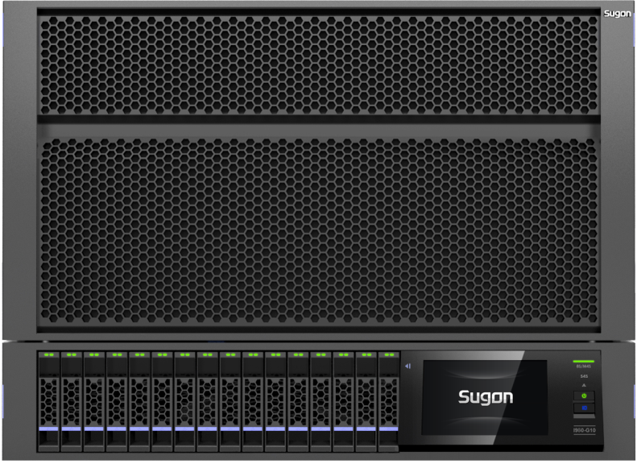
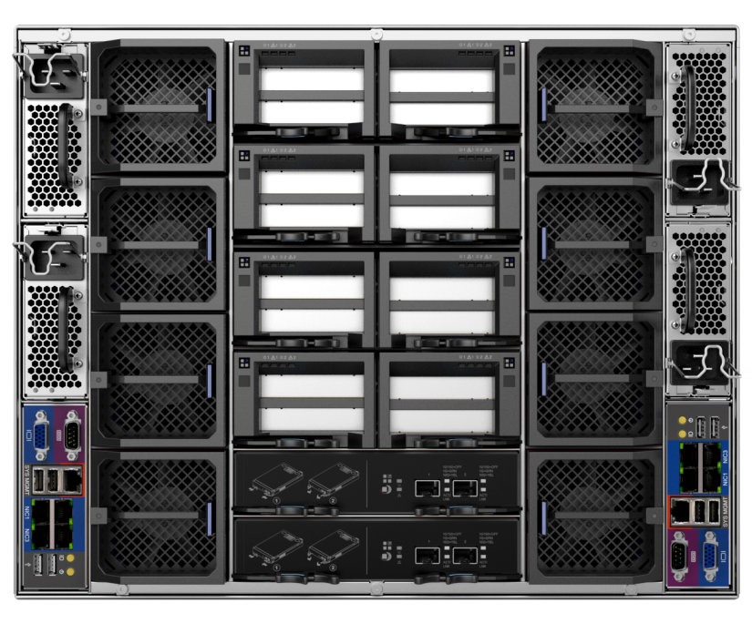
Technical specifications of I980-G10
 | I980-G10
Rake | 8U
Processor | Maximum 8 Intel E7-8800/4800 V2 series of processor can be supported
Chipset | Intel C602J
Memory | Support 128个DIMM slots ，and 8TB ,RDIMMs, DDR3L, LR-DIMM (max)
I/O Expansion | Support 16 PCI-E3.0x8 slots or 4 PCI-E3.0 x16 slots (support GPU、PHY) Support 4 PCI-E3.0 x16 expansive slots(max)； All of IO slots and modules support hot plug
Storage | Maximum 16 2.5 “SAS/ SATA disks and RAID 0,1,5,6 can be supported 2 mSATA disks are optional and supporting RAID0,1 2 One SATA DOM is optional for memory
Network | Integrated Intel I350 4-port Gigabit network card Ten-gigabit network module expansion is optional
Management | Support IPMI 2.0 and rKVM; provide WEB management interface and touch intelligent screen for monitoring
Power supply | Support 4 power supply modules (maximum), each module is 2000W, champion conversion efficiency:92%; redundant N+N or N+1 can be realized.
Notes:
先讲整个IT行业的大背景

Slide 8
10 highlights of I980-G10 server product
Sugon company independently researched and developed it
All the hardware of I980-G10 was developed independently by Sugon: from board to unit, from BMC to BIOS.
Modularization for whole design
CPU board, IOE, power supply, fan, 10-gigabit and management of I980-G10 are independent modules and easy to install and management.
hardware partitioning design
I980-G10 can choose 2 or 4 compute modules. When installing 4 compute modules, you can choose single partition module(8-way) or dual partition module(dual 4-way). They are flexible to meet more need of our clients.
offline-optical diagnosis function
All the CPU and memories of compute module have a pilot light. When bug happens, you can only pull out the module and press switch button on it, and the pilot light of the failure part will be on. So it is very convenient to find out the position of the failure part.
PCI-E hot-plug function
All IOE modules of I980-G10 support hot plug, adding or changing PCI-E without closedown. It has greatly improved maintainability of the server.
Notes:
先讲整个IT行业的大背景

Slide 9
10 highlights of I980-G10 server product
Touch monitoring screen
  Touch monitoring screen of I980-G10 is for checking parts’ status, system information and BMC log. It can be also for setting network, switch, and hardware partitioning.
Fast Video
  Server smart start leads to lighting display. Its right corner showing port 80 code is to know machine self-check schedule and uses code table to quickly figure out the failure situation.
Inserted mSATA hard disk
  Management module has two mSATA interfaces; two 64/128GB mSATA disks can be installed for installing
  operation system.
Powerful BMC monitoring and management function
  BMC can monitor parts such as CPU, memory, disk, power, PCI-E card, fan and network card.
  functions such as remote on-off, virtual media and remote desktop.
  Supporting to refresh BIO and BMC Firmware through BMC Web.
High Performance
  It supports 8 Intel Xeon E7-8800 v2 serials processors. Compared with last generation, its computing performance increases two times that of last generation,its memory is 3 times , and IO bandwidth increases 4 times.
Notes:
先讲整个IT行业的大背景

Slide 10
Contents
1
An overview of I980-G10 server
2
Introduce every module of I980-G10 server
3
Introduce management module of I980-G10 server
4
Structure and installation of I980-G10 server
Notes:
先讲整个IT行业的大背景

Slide 11
Introduction of IOE module
1, Indicator light and button
Slot1 hot-plug bicolor lights（green and yellow）：
green light on shows Slot1 inserted card is working; green light off shows Slot1 inserted card is out of work.
Hot plug in IOE module and its changing process is as follows:
When IOE module is inserted and hot-plug button is not pressed, the hut-plug bicolor lights (yellow and green) are both off.
When hot-plug button is pressed,the yellow light corresponding to Slot in IOE module is flashing and the green light is off.
The yellow light corresponding to Slot in IOE module is off, while the green light is flashing.
The yellow light corresponding to Slot in IOE module is off, while the green light is always flashing.
IOE module is with hot-plug power, the process is finished.
Hot drawing IOE module and its changing process is as follows:
When IOE module is working, the yellow light corresponding to Slot in IOE module is off, while the green light is always flashing.
When hot-plug button is pressed, the green light corresponding to Slot in IOE module is flashing and the yellow light is off.
The yellow light corresponding to Slot in IOE module is off, while the green light is always flashing.
Both the yellow light and the green light are off.
When electricity is completed under IOE module, IOE module can be pulled out.
Slot1 trouble lamp（red）：
Red lamp on means Slot1 in trouble; Red lamp off means Slot1 is normal.
Function of indicator light Slot2 is the same of Slot1
Slot1
Slot2
Notes:
先讲整个IT行业的大背景

Slide 12
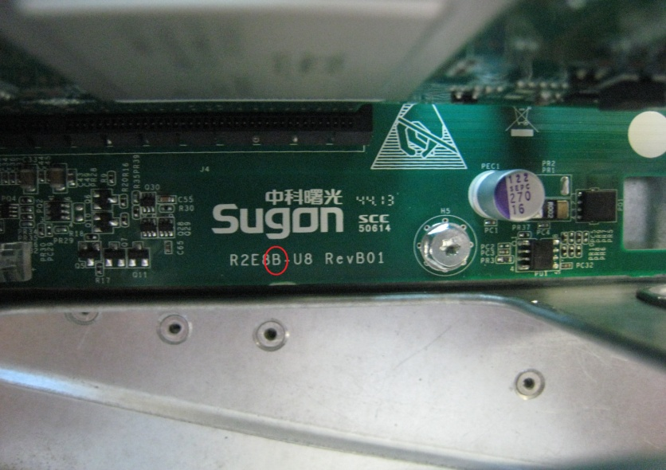
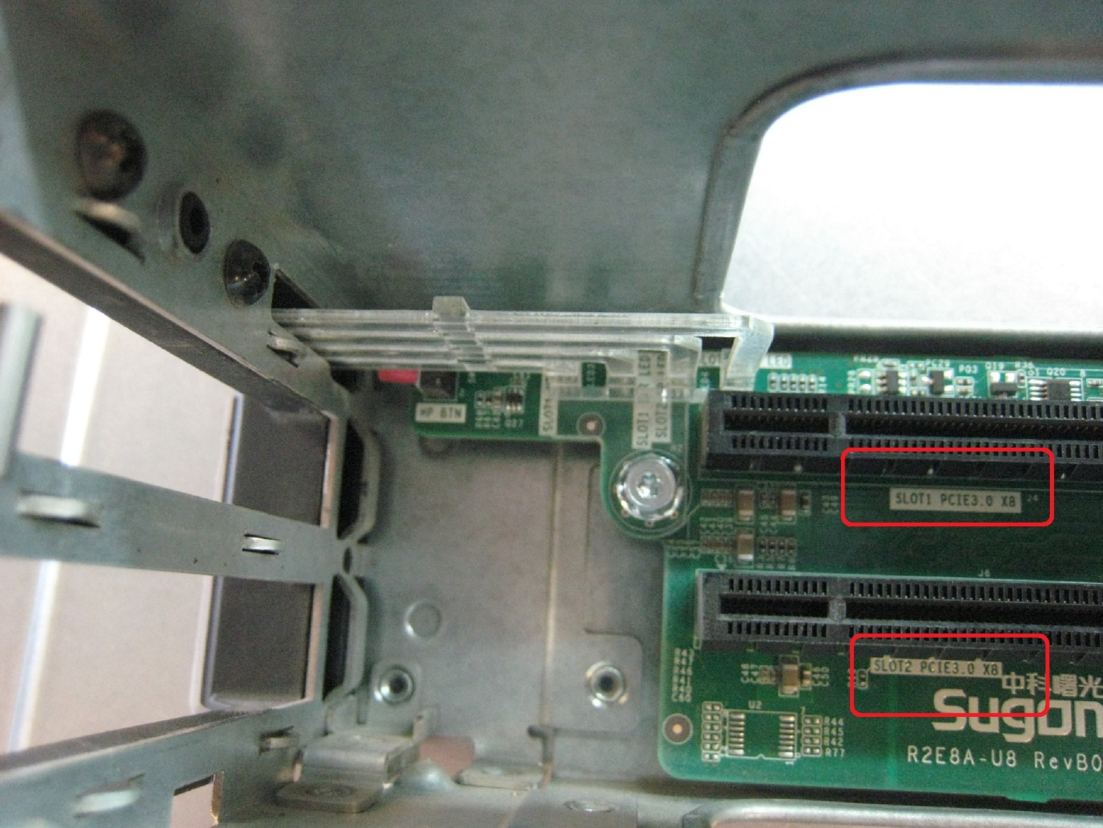
Introduction of IOE module
2、Right and left：the right part of IOE module is different from the left; the last letter A of PCB mode is on the left and that of B is on right; the differences between left and right are also in bracket, and the opposite direction makes trouble for installation.
3、Slot description：IOE module has 2PCIe slots marked as slot1 and slot2; slot1 is preferred for use.
Notes:
先讲整个IT行业的大背景

Slide 13
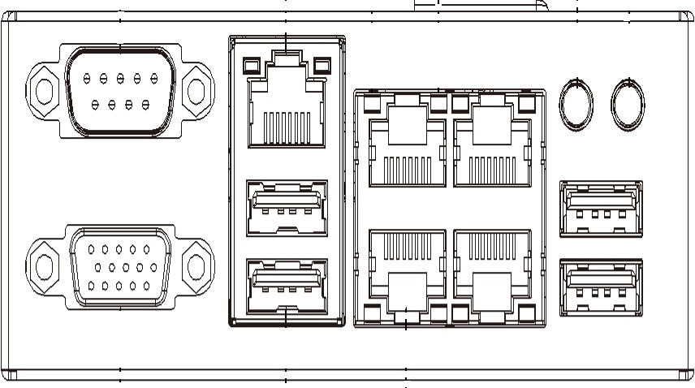
Introduction of management module
1, interfaces, buttons and indicator lights
ID button and indicator light
Switch button and indicator light
serial
IPMI LAN
LAN2 LAN4
LAN1 LAN3
USB
USB
VGA
Notes:
先讲整个IT行业的大背景

Slide 14
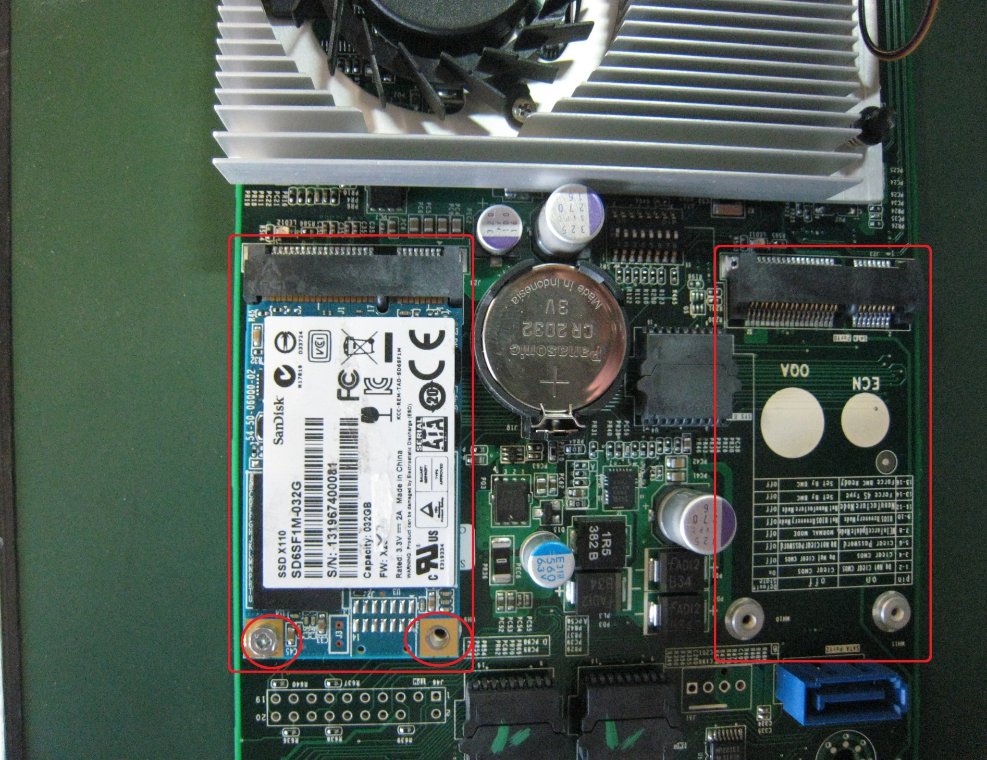
Introduction of management module
2, Internal SSD
Management module has 2 mSATA interfaces and can be installed 2 internal SSDs (as shown in the following picture.)
Port 0
Port 1
SSD installation：put SSD into the interface，and screw the final two screws.
SSD description：the reliability of SSD is a little worse,so it is suggested for the use of installing operation system.
Notes:
先讲整个IT行业的大背景

Slide 15
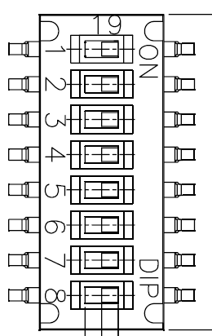
Introduction of management module
3, Introduction of jumper on management module and clearing CMOS method
There is a set of dial switch and its function is as shown in the right picture.
Clearing CMOS method setting: cut off the machine power; take out CMOS battery; make no.1 switch off and no.2 switch; and then wait for one minute.
Pin | On | Off | Default State
1 | Do Not Clear CMOS | Clear CMOS | On
2 | Clear CMOS | Do Not Clear CMOS | Off
3 | Clear Password | Do Not Clear Password | Off
4 | ME In Force Update Mode | Normal Mode | Off
5 | No Function | No Function | Off
6 | Manufacture Mode | Not Manufacture Mode | Off
7 | Force 4S Mode | Set By BMC | Off
8 | Force BMC Ready | Set By BMC | Off
Clearing CMOS code: cut off the machine power; make no.3 switch on and then wait for one minute.
Notes:
先讲整个IT行业的大背景

Slide 16
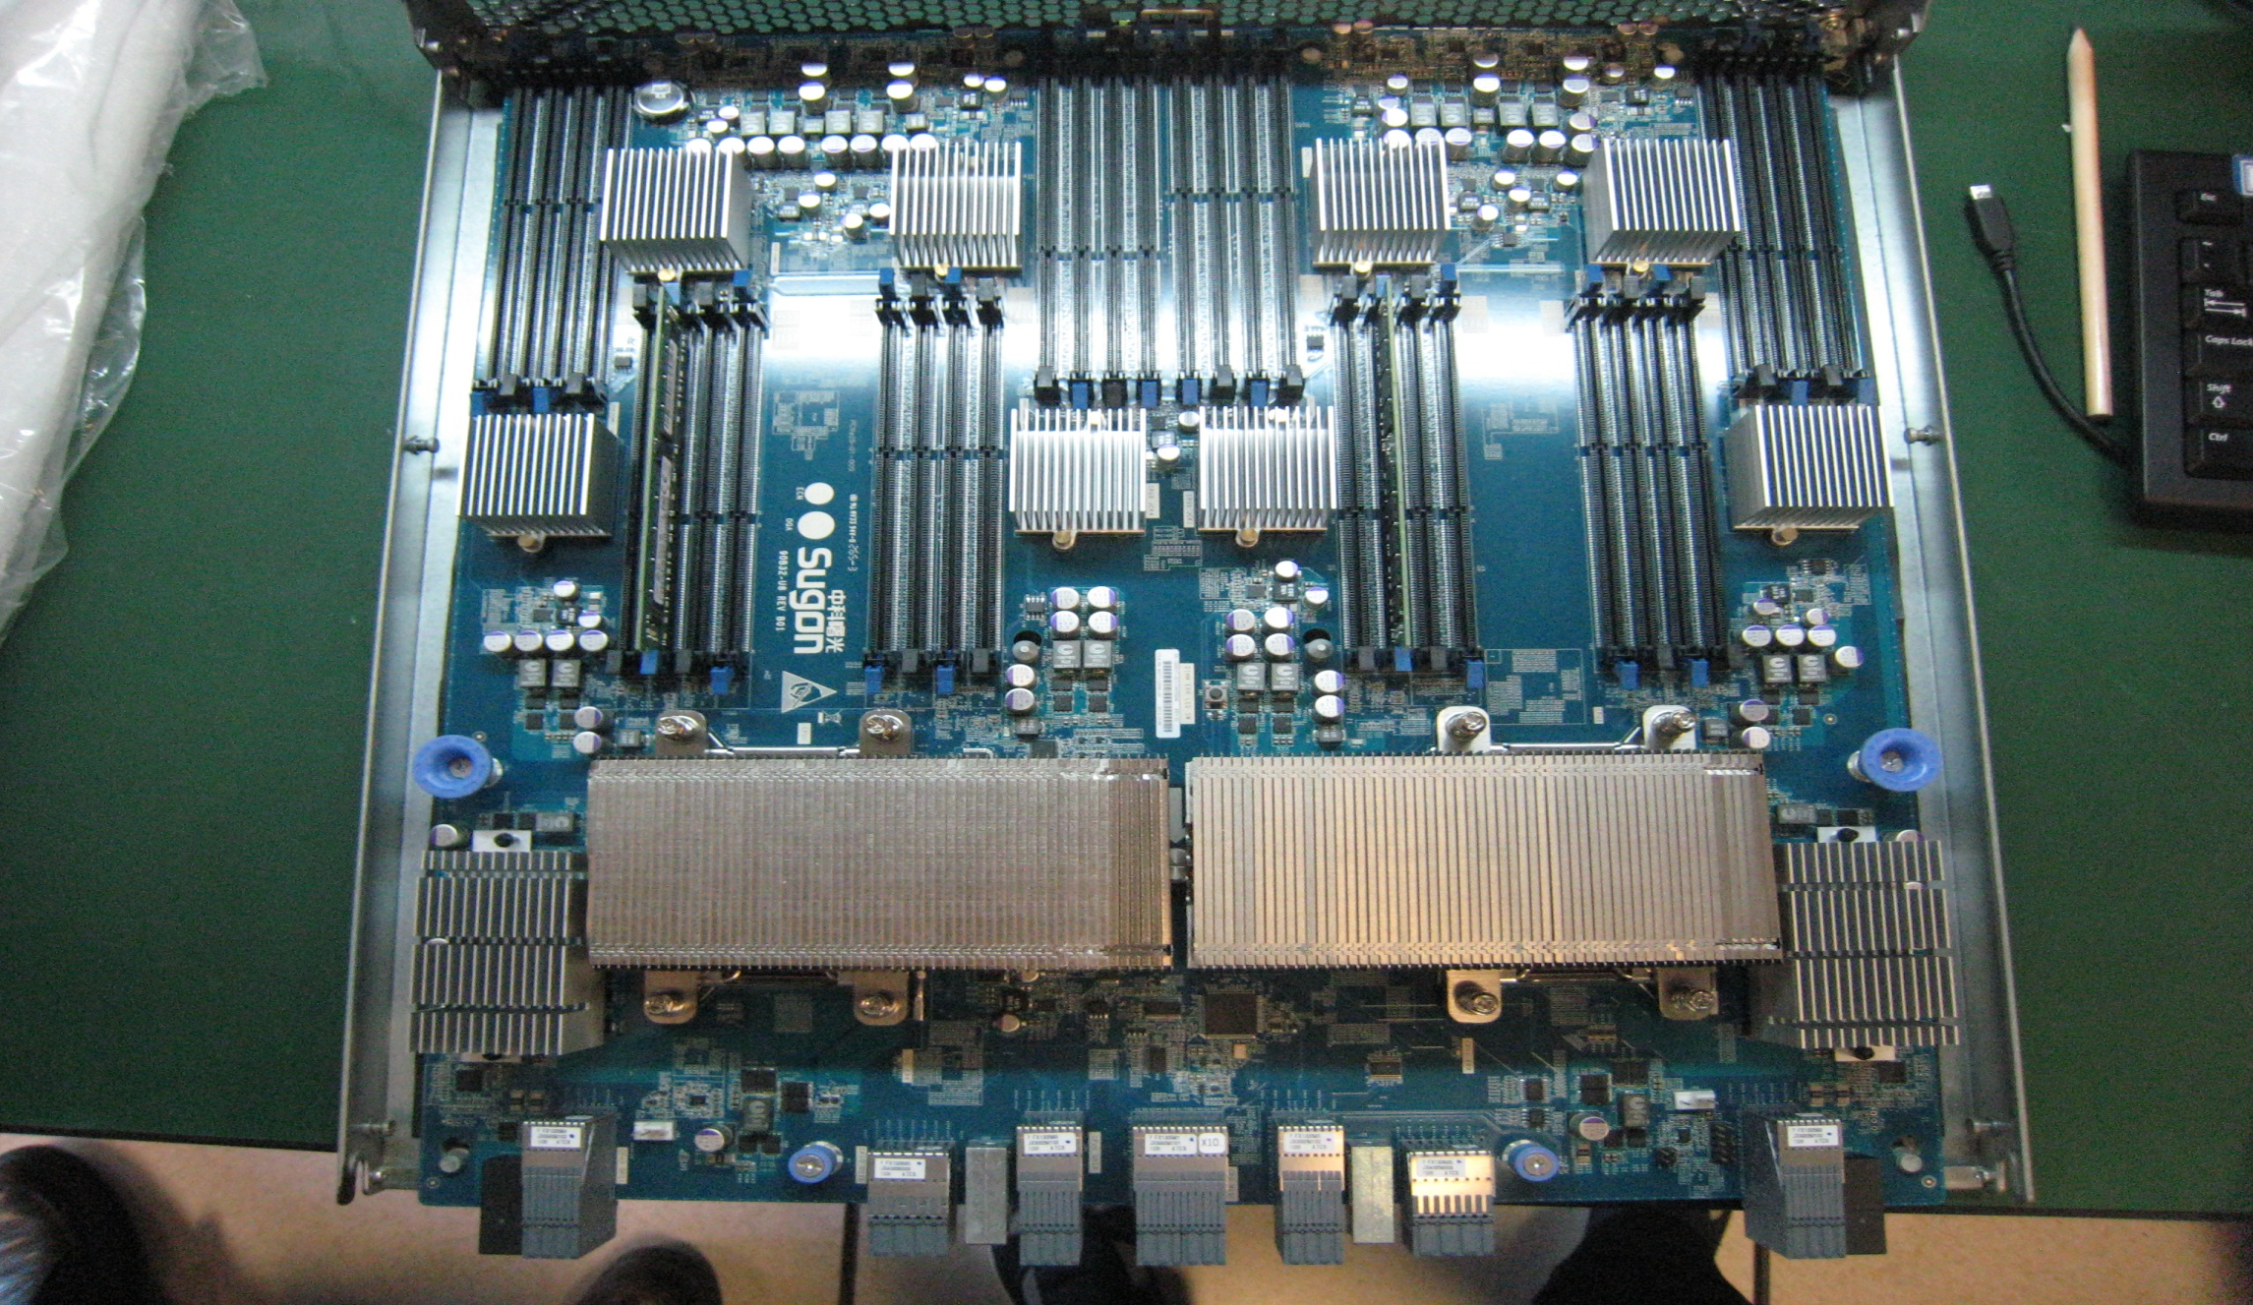
Introduction of computing module
1,Layout introduction
Slots for memory of CPU0
Slots for memory of CPU1
CPU0
CPU1
Notes:
先讲整个IT行业的大背景

Slide 17
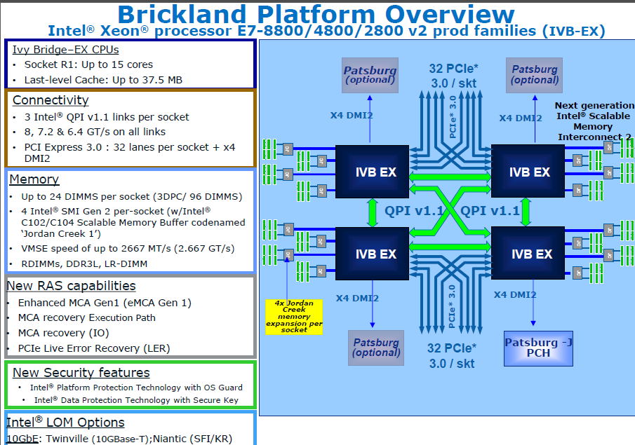
Introduction of computing module
2, Introduction of Intel E7-8800 V2 serial CPU
Notes:
先讲整个IT行业的大背景

Slide 18
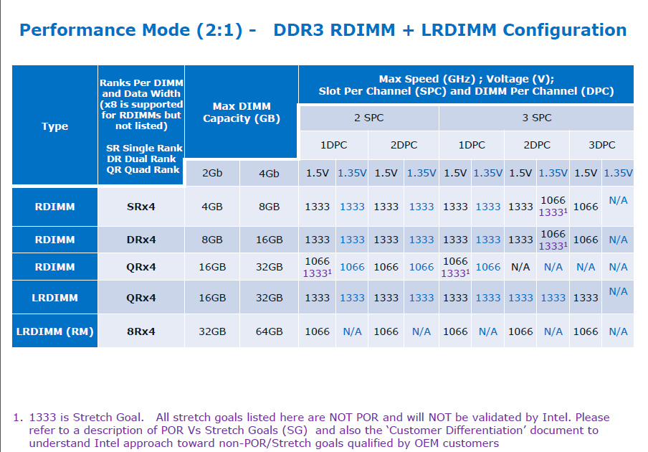
Introduction of computing module
3, Introduction of memory supporting situation-- Performance Mode
Notes:
先讲整个IT行业的大背景

Slide 19
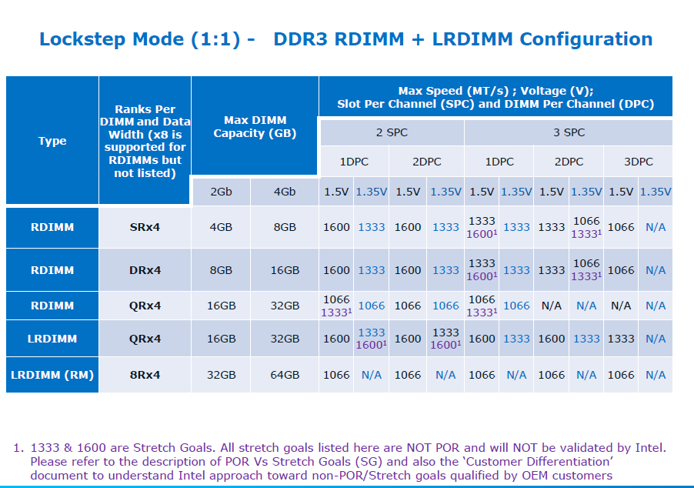
Introduction of computing module
4,Introduction of memory supporting situation--Lockstep Mode
Notes:
先讲整个IT行业的大背景

Slide 20
Introduction of computing module
5, button and indicator light
Alarm indicator on computing module（orange）：
On：computing module is abnormal
Off：computing module is normal
Hot-plug indicator lights on computing module（yellow and green）：
Green light on：computing module is energized.
Green light off：computing module is not energized.
Hot-pug button of computing module and its hot-plug process is the same with IOE module.
Hot-plug function of computing module only can be used supported by OS!
Notes:
先讲整个IT行业的大背景

Slide 21
Introduction of computing module
6, offline-optical diagnosis function
When mainboard failure happens, pull out it and press the following button; if error is in memory or CPU, its light will be on.
CPU indicator light
Memory indicator
Notes:
先讲整个IT行业的大背景

Slide 22
Introduction of computing module
7, corresponding relationship of CPU CPU under OS
and physical CPU
CPU under OS | Physical CPU
CPU 0 | CM1 CPU0
CPU 1 | CM1 CPU1
CPU 2 | CM3 CPU1
CPU 3 | CM3 CPU0
CPU 4 | CM2 CPU0
CPU 5 | CM2 CPU1
CPU 6 | CM4 CPU1
CPU 7 | CM4 CPU0
CM4 CPU1 (6) CM4 CPU0 (7)
CM3 CPU1 (2) CM3 CPU0 (3)
CM2 CPU1 (5) CM2 CPU0 (4)
CM1 CPU1 (1) CM1 CPU0 (0)
Note：CM1 CPU0 is CPU0 on computing module 1 and so on；number in () is CPU’s number under OS.
Notes:
先讲整个IT行业的大背景

Slide 23
Introduction of computing module
8, Installing principles of computing module and memory
Installing principles of computing module:
Each CPU board must be installed with 2 CPUs；
2 or 4 CPU boards can be chosen for installation；
2 CPU boards are installed in slot1 and slot3.
Installing principles of memory:
Each CPU has 16 memory slots:A1、A2、B1、B2……H1、H2;prefer to install slots with 1, and make sure symmetrical installation, that is to say, in order of priority:A1>E1>C1>G1>B1>D1>F1>H1; and then install slots with 2, in order of priority as above.
Refer to the following memory interpolation table.
Notes:
先讲整个IT行业的大背景

Slide 24
Introduction of computing module
Memory interpolation table - 1 (Example of 4 CPUs.With 8 CPUs, CPU5~8 and CPU1~4 are symmetric interpolating)
Amount of memory | 4 | 8 | 10 | 12 | 16 | 20 | 24 | 32 | 36 | 40 | 48 | 64
P1_A1 | × | × | × | × | × | × | × | × | × | × | × | ×
P1_A2 |  |  |  |  |  |  |  |  | × | × | × | ×
P1_B1 |  |  |  |  |  | × | × | × | × | × | × | ×
P1_B2 |  |  |  |  |  |  |  |  |  |  |  | ×
P1_C1 |  |  | × | × | × | × | × | × | × | × | × | ×
P1_C2 |  |  |  |  |  |  |  |  | × | × | × | ×
P1_D1 |  |  |  |  |  | × |  | × | × | × | × | ×
P1_D2 |  |  |  |  |  |  |  |  |  |  |  | ×
P1_E1 |  | × | × | × | × | × | × | × | × | × | × | ×
P1_E2 |  |  |  |  |  |  |  |  | × | × | × | ×
P1_F1 |  |  |  |  |  | × | × | × | × | × | × | ×
P1_F2 |  |  |  |  |  |  |  |  |  |  |  | ×
P1_G1 |  |  | × |  | × | × | × | × | × | × | × | ×
P1_G2 |  |  |  |  |  |  |  |  | × | × | × | ×
P1_H1 |  |  |  |  |  | × |  | × | × | × | × | ×
P1_H2 |  |  |  |  |  |  |  |  |  |  |  | ×
Notes:
先讲整个IT行业的大背景

Slide 25
Introduction of computing module
Memory interpolation table - 2 (Example of 4 CPUs.With 8 CPUs, CPU5~8 and CPU1~4 are symmetric interpolating)
Amount of memory | 4 | 8 | 10 | 12 | 16 | 20 | 24 | 32 | 36 | 40 | 48 | 64
P2_A1 | × | × | × | × | × | × | × | × | × | × | × | ×
P2_A2 |  |  |  |  |  |  |  |  |  | × | × | ×
P2_B1 |  |  |  |  |  |  | × | × | × | × | × | ×
P2_B2 |  |  |  |  |  |  |  |  |  |  |  | ×
P2_C1 |  |  |  | × | × | × | × | × | × | × | × | ×
P2_C2 |  |  |  |  |  |  |  |  |  | × | × | ×
P2_D1 |  |  |  |  |  |  |  | × | × | × | × | ×
P2_D2 |  |  |  |  |  |  |  |  |  |  |  | ×
P2_E1 |  | × | × | × | × | × | × | × | × | × | × | ×
P2_E2 |  |  |  |  |  |  |  |  |  | × | × | ×
P2_F1 |  |  |  |  |  |  | × | × | × | × | × | ×
P2_F2 |  |  |  |  |  |  |  |  |  |  |  | ×
P2_G1 |  |  |  |  | × | × | × | × | × | × | × | ×
P2_G2 |  |  |  |  |  |  |  |  |  | × | × | ×
P2_H1 |  |  |  |  |  |  |  | × | × | × | × | ×
P2_H2 |  |  |  |  |  |  |  |  |  |  |  | ×
Notes:
先讲整个IT行业的大背景

Slide 26
Introduction of computing module
Memory interpolation table - 3 (Example of 4 CPUs.With 8 CPUs, CPU5~8 and CPU1~4 are symmetric interpolating)
Amount of memory | 4 | 8 | 10 | 12 | 16 | 20 | 24 | 32 | 36 | 40 | 48 | 64
P3_A1 | × | × | × | × | × | × | × | × | × | × | × | ×
P3_A2 |  |  |  |  |  |  |  |  |  |  | × | ×
P3_B1 |  |  |  |  |  |  | × | × | × | × | × | ×
P3_B2 |  |  |  |  |  |  |  |  |  |  |  | ×
P3_C1 |  |  |  | × | × | × | × | × | × | × | × | ×
P3_C2 |  |  |  |  |  |  |  |  |  |  | × | ×
P3_D1 |  |  |  |  |  |  |  | × | × | × | × | ×
P3_D2 |  |  |  |  |  |  |  |  |  |  |  | ×
P3_E1 |  | × | × | × | × | × | × | × | × | × | × | ×
P3_E2 |  |  |  |  |  |  |  |  |  |  | × | ×
P3_F1 |  |  |  |  |  |  | × | × | × | × | × | ×
P3_F2 |  |  |  |  |  |  |  |  |  |  |  | ×
P3_G1 |  |  |  |  | × | × | × | × | × | × | × | ×
P3_G2 |  |  |  |  |  |  |  |  |  |  | × | ×
P3_H1 |  |  |  |  |  |  |  | × | × | × | × | ×
P3_H2 |  |  |  |  |  |  |  |  |  |  |  | ×
Notes:
先讲整个IT行业的大背景

Slide 27
Introduction of computing module
Memory interpolation table - 4 (Example of 4 CPUs.With 8 CPUs, CPU5~8 and CPU1~4 are symmetric interpolating)
Amount of memory | 4 | 8 | 10 | 12 | 16 | 20 | 24 | 32 | 36 | 40 | 48 | 64
P4_A1 | × | × | × | × | × | × | × | × | × | × | × | ×
P4_A2 |  |  |  |  |  |  |  |  |  |  | × | ×
P4_B1 |  |  |  |  |  |  | × | × | × | × | × | ×
P4_B2 |  |  |  |  |  |  |  |  |  |  |  | ×
P4_C1 |  |  |  | × | × | × | × | × | × | × | × | ×
P4_C2 |  |  |  |  |  |  |  |  |  |  | × | ×
P4_D1 |  |  |  |  |  |  |  | × | × | × | × | ×
P4_D2 |  |  |  |  |  |  |  |  |  |  |  | ×
P4_E1 |  | × | × | × | × | × | × | × | × | × | × | ×
P4_E2 |  |  |  |  |  |  |  |  |  |  | × | ×
P4_F1 |  |  |  |  |  |  | × | × | × | × | × | ×
P4_F2 |  |  |  |  |  |  |  |  |  |  |  | ×
P4_G1 |  |  |  |  | × | × | × | × | × | × | × | ×
P4_G2 |  |  |  |  |  |  |  |  |  |  | × | ×
P4_H1 |  |  |  |  |  |  |  | × | × | × | × | ×
P4_H2 |  |  |  |  |  |  |  |  |  |  |  | ×
Notes:
先讲整个IT行业的大背景

Slide 28
Introduction of monitoring screen
8S/M4S indicator
S4S indicator
system failure indicator
switch light
ID button light
1, 8S/M4S indicator: it will be on when main 4-way of single 8-way or dual 4-way server is powered.
2, S4S indicator: only when the system is set into dual 4-way mode and sub 4-way is powered, it will be on.
3, The switch can control main 4-way server of single 8-way and dual partitioning. Sub 4-way server is controlled by the switch of management module.
4, ID button only control MM1(main management module)ID light but cannot control MM2( sub-management module)ID light.
Notes:
先讲整个IT行业的大背景

Slide 29
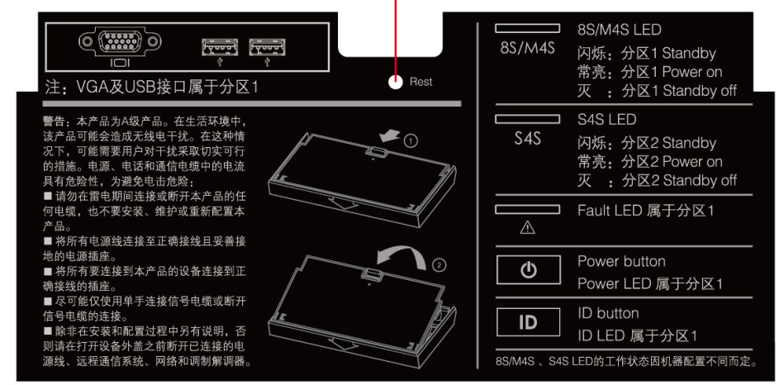
Introduction of monitoring screen
5, sketch on the back of monitoring screen
Notes:
先讲整个IT行业的大背景

Slide 30
Introduction of 10-gigabit module
1,interface, button and indicator light
1 | Hot-plug button（hot-plug progress is the same with IOE module）
2 | Alarm indicator （red） on：module is abnormal off：module is normal
3 | Hot-plug bicolor lights green light on：on：module is at work green light off：module is not at work
4 | 10-gigabit interface #1
7 | 10-gigabit interface #2
5、8 | ACT/LNK indicator light off：non-connection green light always on：connected green light flashing：data transmission
6、9 | Speed indicator lights off：10/100Mbps green：1000Mbps yellow：10Gbps
Notes:
先讲整个IT行业的大背景

Slide 31
Introduction of power module—indicator light
1, Introduction of indicator light
Power state light (green) | Power failure light (amber) | State descriptions
off | off | Power module is not connected with AC power.
flashing | off | Power module connected with AC power but doesn’t work.
Always on | Off | Power module is working normally.
off | On | Power module has trouble in working.
Always on | Flashing | Over Current Protection
Power state light
Power failure light
Notes:
先讲整个IT行业的大背景

Slide 32

Introduction of power module
2,installing order
Places of 4 power modules are totally the same in design and they can be installed anyway. But considering the need of beauty and style unified, the order of priority is: PSU1>PSU4>PSU2>PSU3。
Notes:
先讲整个IT行业的大背景

Slide 33
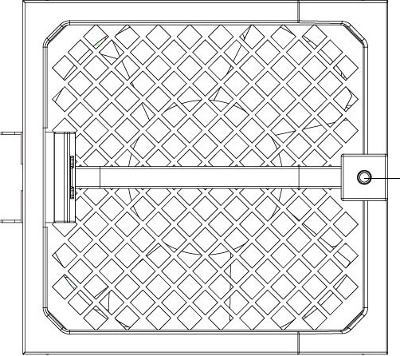
Introduction of fan module
1, introduction of indicator light
Fan state indicator light
off：fans are not working
Green light on：fan working state is normal
Red light on：fan working state is abnormal
Notes:
先讲整个IT行业的大背景

Slide 34
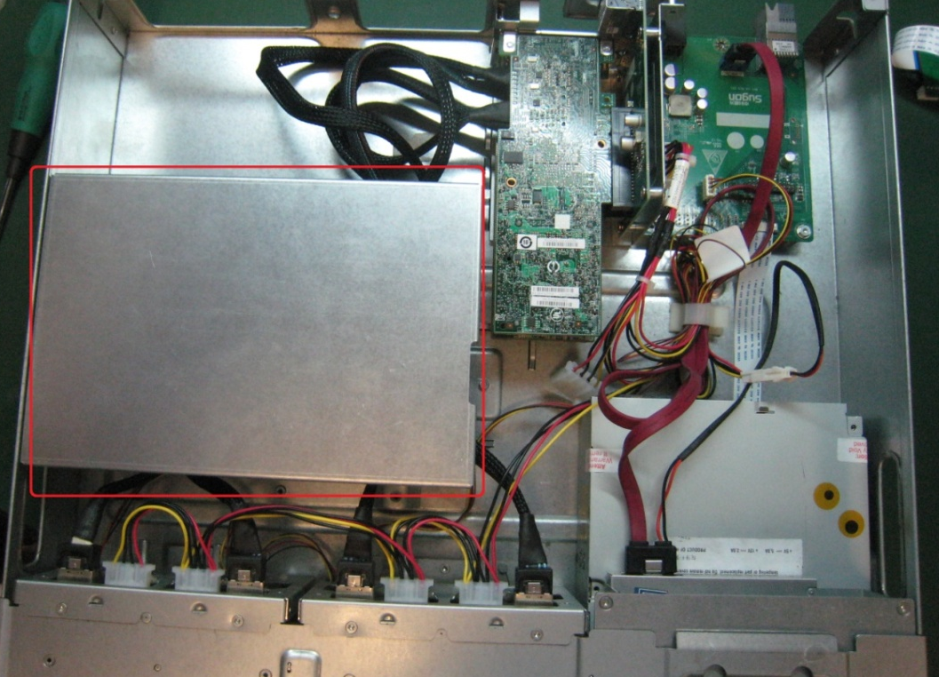
Introduction of storage and front panel
1, location description：as the right picture shows: storage and front panel are in the red boxes; after removing the screws,it can be extracted.
Riser card
Monitoring board
RAID card
Wire slot
2、inside description：there are monitoring board, Riser card, RSID card, drive, front board, tape and wire management inside the storage and front panel.
tape
drive
Notes:
先讲整个IT行业的大背景

Slide 35
Contents
1
An overview of I980-G10 server
2
Introduce every module of I980-G10 server
3
Introduce management module of I980-G10 server
4
Structure and installation of I980-G10 server
Notes:
先讲整个IT行业的大背景

Slide 36
Powerful IPMI monitoring function
Introduction of I980-G10 BMC Sensor
classification | sensor name | description |  | classification | sensor name | description
Computing module Sensor | CM1 Temp | 1# mainboard temperature of computing module |  | Management module Sensor | PCH Temp | management module temperature
 | CM1 CPU0 Temp | CPU temperature |  |  | Onboard NIC Temp | Temperature of Onboard NIC
 | CM1 CPU1 Temp |  |  |  | BMC Temp | BMC temperature
 | CM1 Outlet Temp1 | Outlet temperature |  |  | PCH 1.1V | Voltage of management module
 | CM1 Outlet Temp2 |  |  |  | PCH 1.5V
 | CM1 CPU0 MEM VR | Memory voltage |  |  | 12V
 | CM1 CPU1 MEM VR |  |  |  | 5V
 | CM1 CPU0 Vcore | CPU voltage |  |  | 3.3V
 | CM1 CPU1 Vcore |  |  |  | Vbat
 | CM1 CPU0 VCCIO |  |  | IOE module Sensor | IOE1~8 Temp | Temperature of IOE module
 | CM1 CPU1 VCCIO
Power module Sensor | PSU1_Vin | Input voltage |  | Fan module Sensor | FanMoudle1~8 | Fan module is working
 |  |  |  |  | Fan1~8 | Fan rate
 | PSU1_Iin | Input current |  | Disk Sensor | HDD0~15 | Disk is working
 | PSU1_Pin | input power
 | PSU1_Fan1 | Fan rate of power module |  | Description ：there are four computing modules and four power modules. Each module has a same set of Sensor.
 | PSU1_Fan2
 | PSU1_Temp1 | power module temperature
 | PSU1_Temp2
 | PSU1_Vout | Output voltage
Notes:
先讲整个IT行业的大背景

Slide 37
Powerful IPMI monitoring function
Introduction of I980-G10 BMC log and parts monitoring
I980-G10 BMC has three types of logs：Event Log、System Log、Audit Log。
Event Log：recording all Sensor warning logs and BIOS reporting failure logs in startup process.
System Log：recording logs from operating system.
Audit Log：recording los of BMC user login and operating.
I980-G10 BMC can monitor such information of CPU, memory, inserted SSD, disk, power, fans, PCI-E card, Onboard NIC, external network card.
Notes:
先讲整个IT行业的大背景

Slide 38
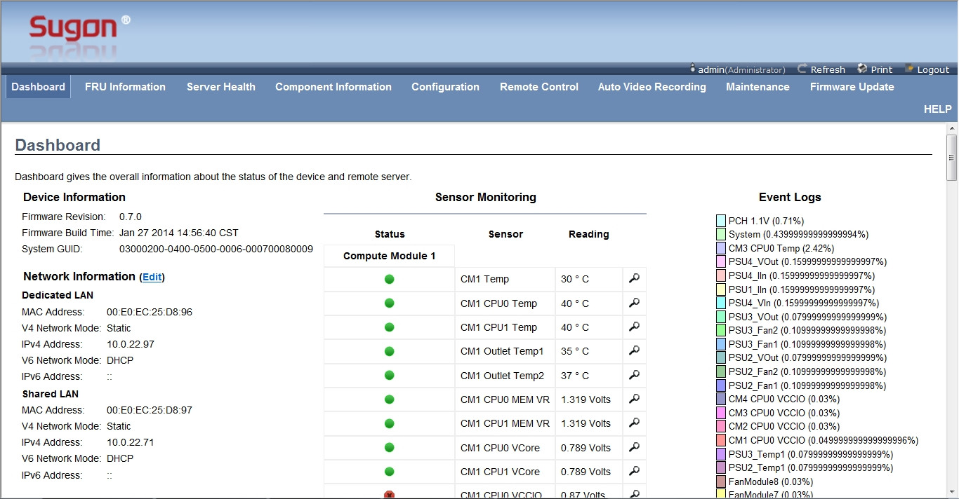
Powerful IPMI monitoring function
I980-G10 BMC Dashboard page
Username and password: admin
menu bar
Function button area
Device information
area
Log statistics area
Network setting
area
Sensor sate area
Notes:
先讲整个IT行业的大背景

Slide 39
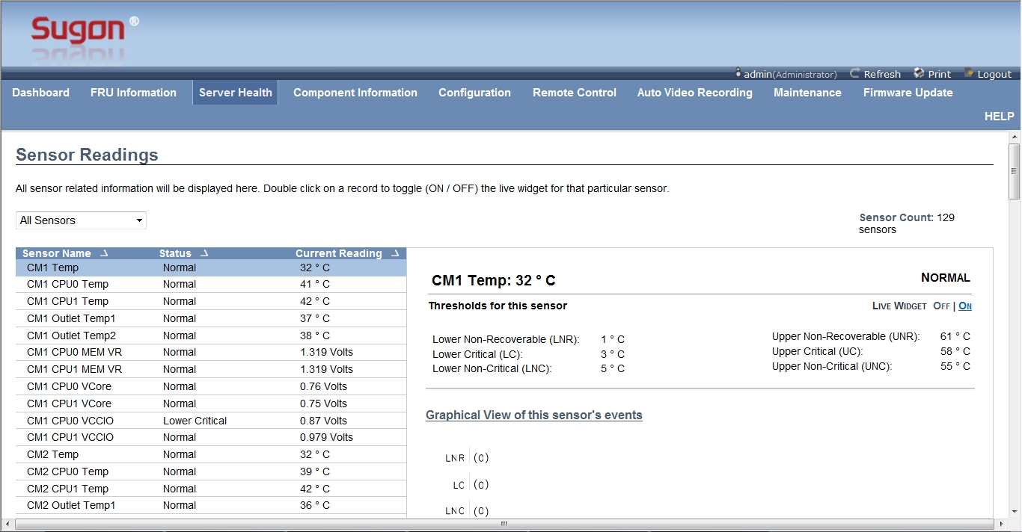
Powerful IPMI monitoring function
I980-G10 BMC Sensor Readings page
Sensor filter
Threshold information of selected sensor
All sensor
lists
选定sensor的相关日志统计图
Notes:
先讲整个IT行业的大背景

Slide 40
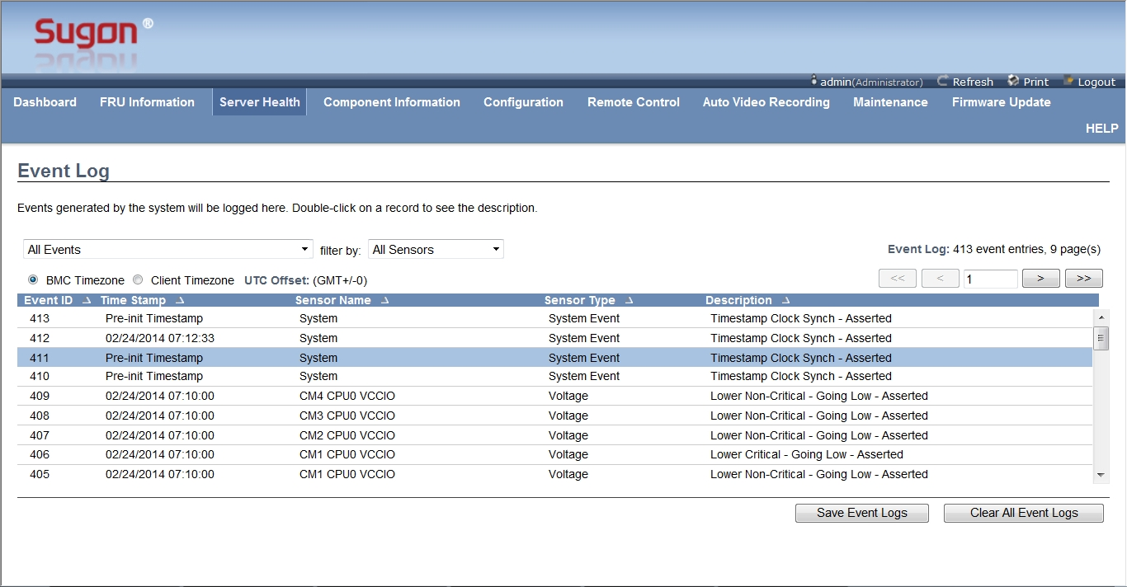
Powerful IPMI monitoring function
I980-G10 BMC Event Log page
Select logs according to Sensor
Select logs from log sources
Turning button
Set log time and display mode
Log lists
Save logs as local files
Clear log
Notes:
先讲整个IT行业的大背景

Slide 41
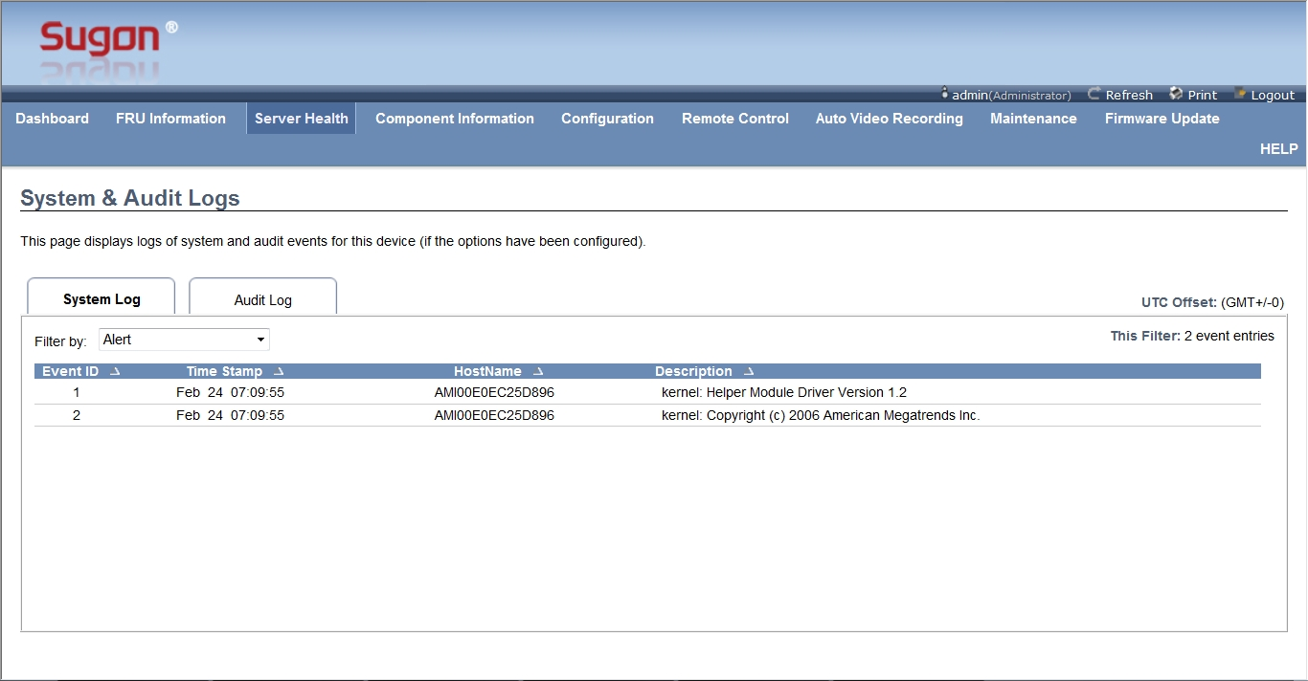
Powerful IPMI monitoring function
I980-G10 BMC System and Audit Log page
Click it and can check system logs
Click it and can check auditing logs
Log lists area
Notes:
先讲整个IT行业的大背景

Slide 42
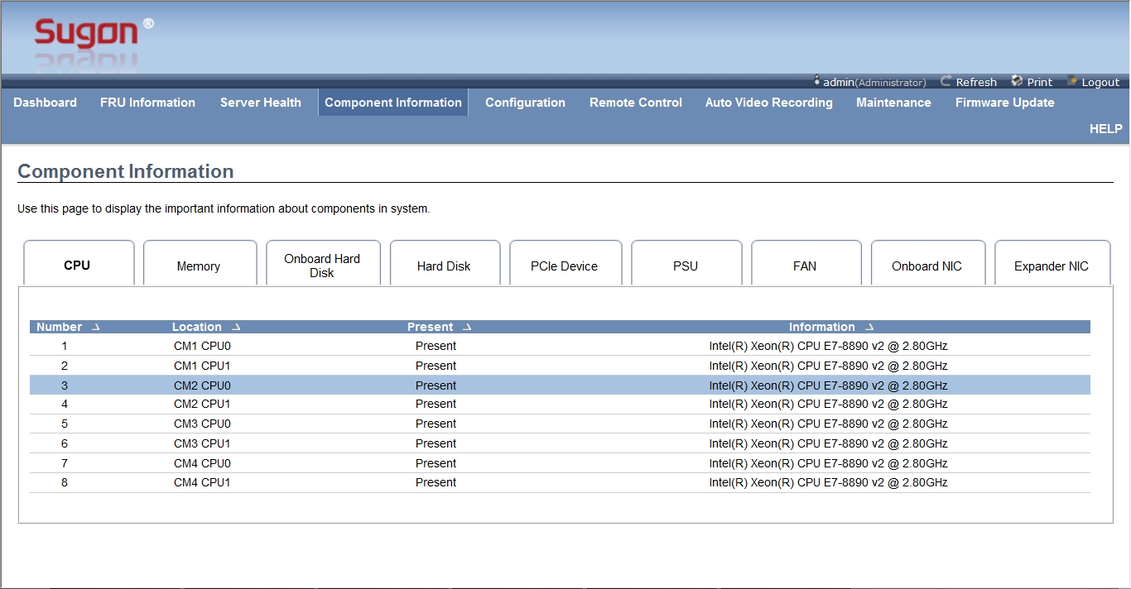
Powerful IPMI monitoring function
I980-G10 BMC Component Information – CPU page
Tabs can monitor CPU, memory,onboard SSD,disk, PCIe card, power, fans and network card.
CPU location information
CPU at work sate
CPU type information
Notes:
先讲整个IT行业的大背景

Slide 43
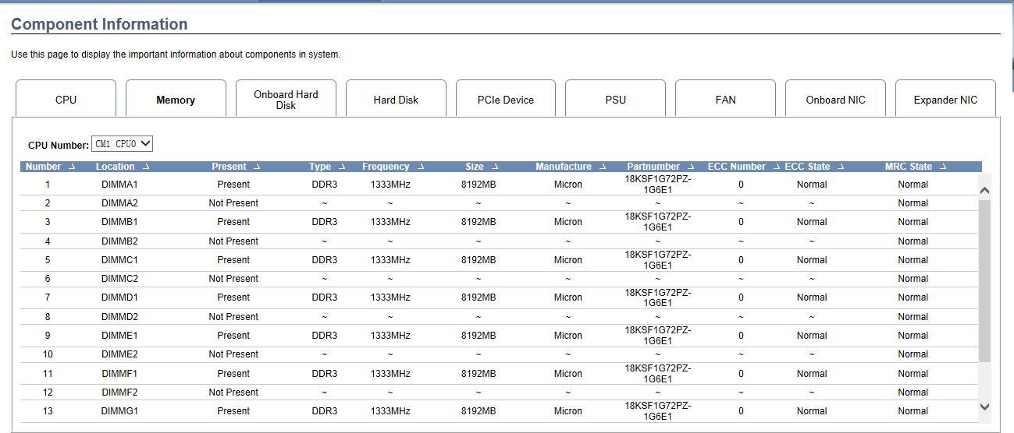
Powerful IPMI monitoring function
I980-G10 BMC Component Information – Memory page
It can monitor such memory information as memory slots, working state, types, capacity, manufacture, mode, ECC state and MRC state.
Notes:
先讲整个IT行业的大背景

Slide 44
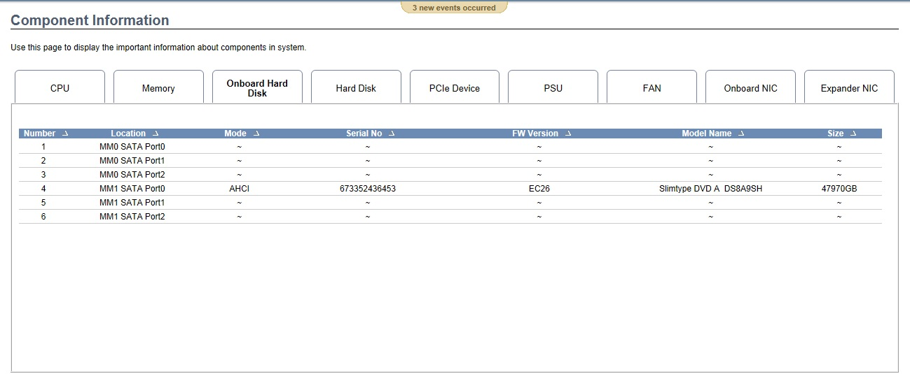
Powerful IPMI monitoring function
I980-G10 BMC Component Information – Onboard Hard Disk page
It can monitor such information as location, mode, number, FW edition, type and capacity of onboard SSD.
Notes:
先讲整个IT行业的大背景

Slide 45
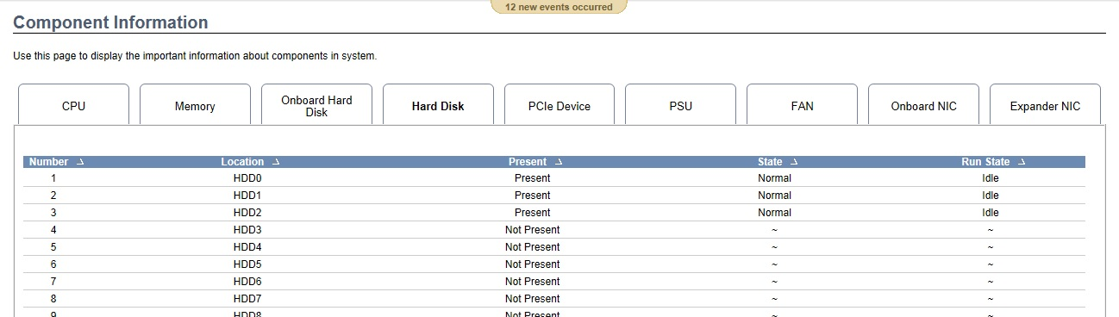
Powerful IPMI monitoring function
I980-G10 BMC Component Information – Hard Disk page
It can monitor such information as location, working state, capacity and running state of hard disk device.
Notes:
先讲整个IT行业的大背景

Slide 46
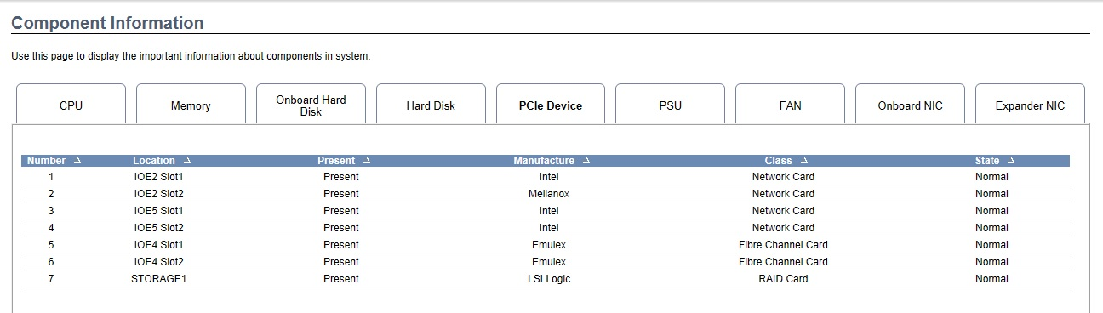
Powerful IPMI monitoring function
I980-G10 BMC Component Information – PCIe Device page
It can monitor such information as location, working state, manufacture, types and state of PCIe device.
Notes:
先讲整个IT行业的大背景

Slide 47
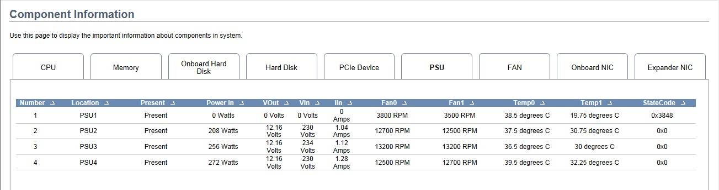
Powerful IPMI monitoring function
I980-G10 BMC Component Information – PSU page
It can monitor such information as location, working state, input power, input voltage, input current, power fan rate, power temperature and status code of power module.
Notes:
先讲整个IT行业的大背景

Slide 48
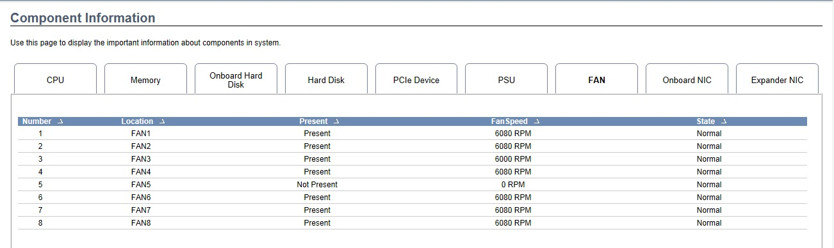
Powerful IPMI monitoring function
I980-G10 BMC Component Information – FAN page
It can monitor such information as location, working state, rate and state of fan module.
Notes:
先讲整个IT行业的大背景

Slide 49
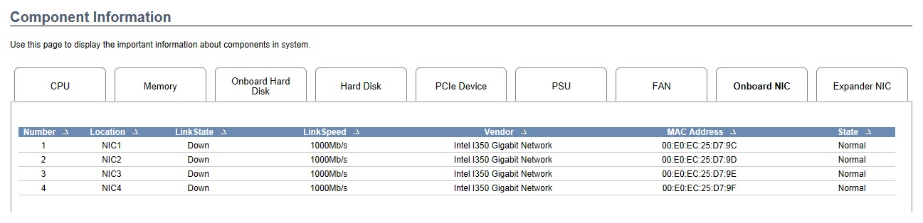
Powerful IPMI monitoring function
I980-G10 BMC Component Information – Onboard NIC page
It can monitor such information as location, link state, manufacture mode, MAC address and state of Onboard NIC .
Notes:
先讲整个IT行业的大背景

Slide 50
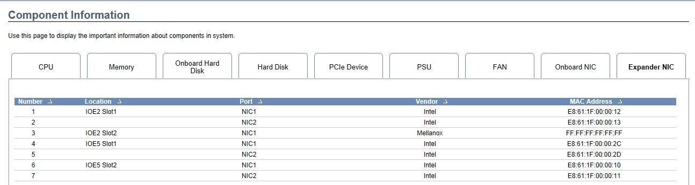
Powerful IPMI monitoring function
I980-G10 BMC Component Information – Expander NIC page
It can monitor such information as location, port, manufacture and MAC address of Expander NIC.
Notes:
先讲整个IT行业的大背景

Slide 51
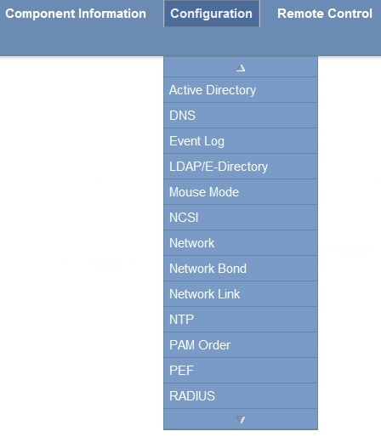
Powerful IPMI monitoring function
Introduction of I980-G10 BMC Configuration submenu-1
submenu | function
Active Directory | Set activity directory
DNS | Set Domain Name Service
Event Log | Set strategies of system log
LDAP/E-Directory | Set lightweight directory access
Mouse Mode | Set mouse mode
NCSI | Set external network
Network | Set network port
Network Bond | Set network convergence
Network Link | Set BMC using port
NTP | Set network time lock
PAM Order | Set order of login module
PEF | Set event filter
RADIUS | Set RADIUS
Notes:
先讲整个IT行业的大背景

Slide 52
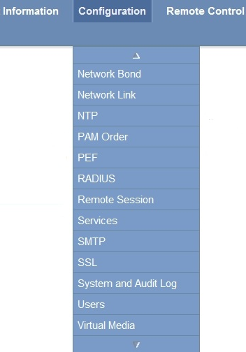
Powerful IPMI monitoring function
Introduction of I980-G10 BMC Configuration submenu-2
submenu | function
Remote Session | Set remote conversation
Services | Set service of BMC running
SMTP | Set the simple mail transfer protocol
SSL | Set secure socket layer
System and Audit Log | Set system logs and auditing logs
Users | Set BMC user
Virtual Media | Set virtual media function
Notes:
先讲整个IT行业的大背景

Slide 53
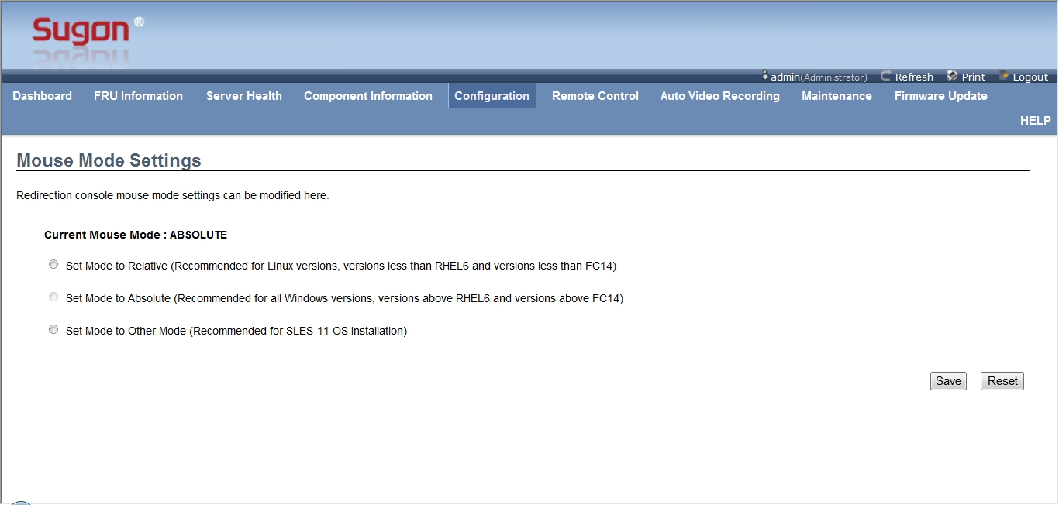
Powerful IPMI monitoring function
Introduction of I980-G10 BMC Mouse Mode menu
Relative mode, for Linux system
Absolute mode，for Windows system
Other mode，for SLES-11 system
Notes:
先讲整个IT行业的大背景

Slide 54
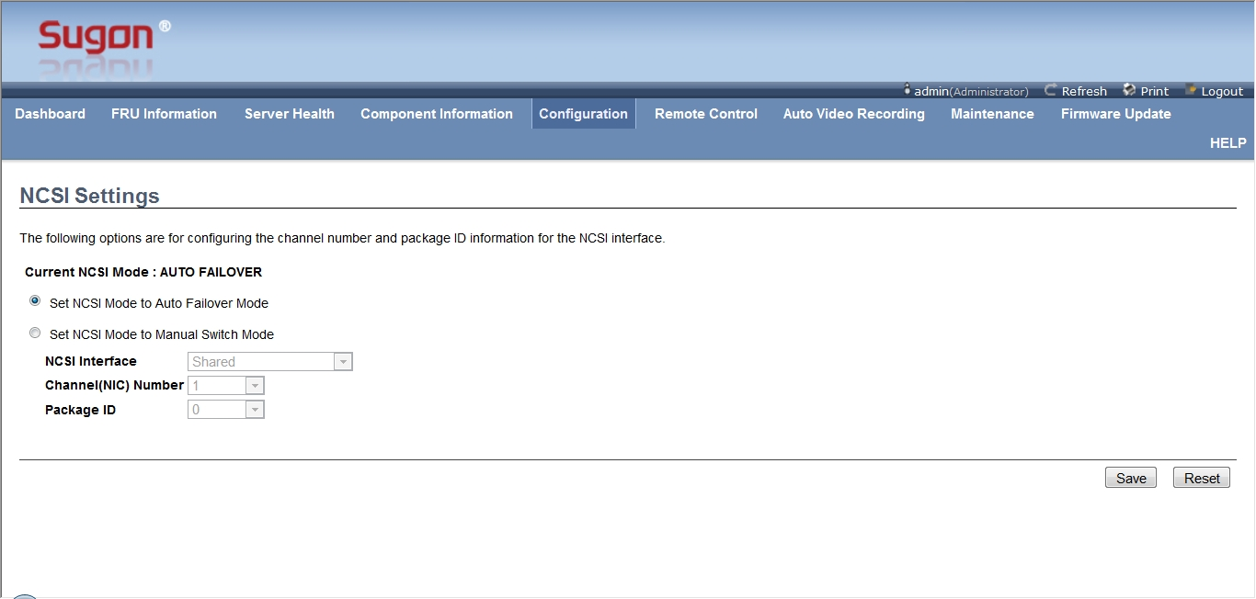
Powerful IPMI monitoring function
Introduction of I980-G10 BMC NCSI menu
Set mode of automatic failover
Manual setting
Notes:
先讲整个IT行业的大背景

Slide 55
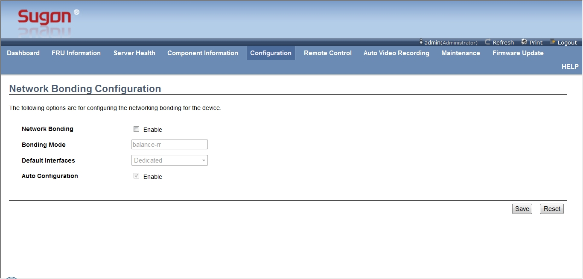
Powerful IPMI monitoring function
Introduction of I980-G10 BMC Network Bond menu
Selecting it starts Network Bond function
After starting, default interface is for option
Selecting it starts auto-configuration
Notes:
先讲整个IT行业的大背景

Slide 56
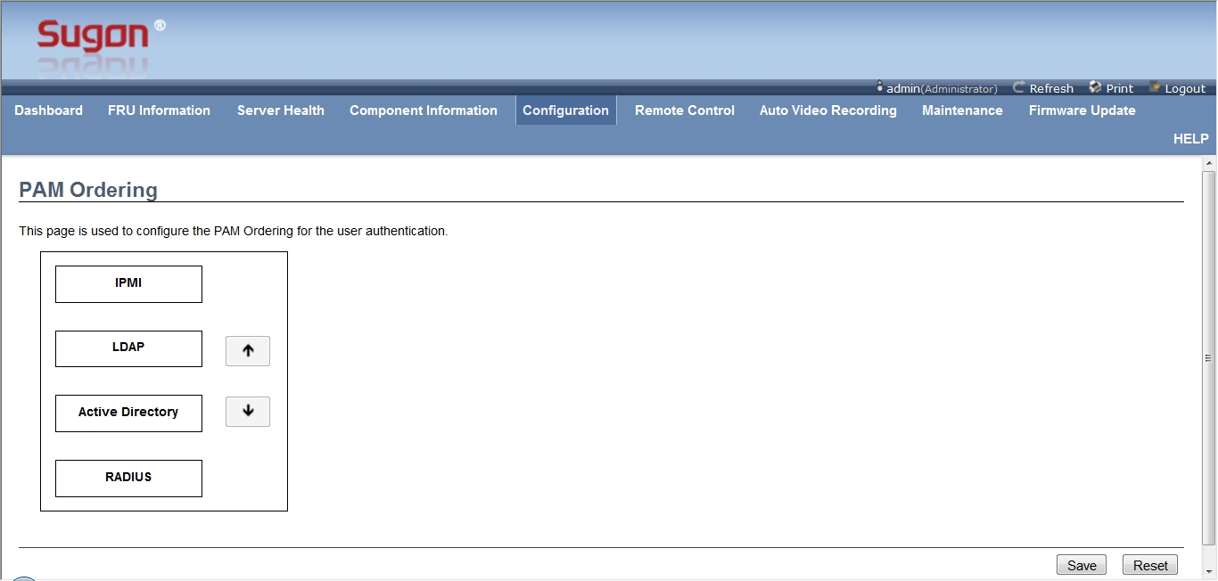
Powerful IPMI monitoring function
Introduction of I980-G10 BMC PAM Order menu
Click it and choose different modules.
Click up/down button to adjust module order.
Notes:
先讲整个IT行业的大背景

Slide 57
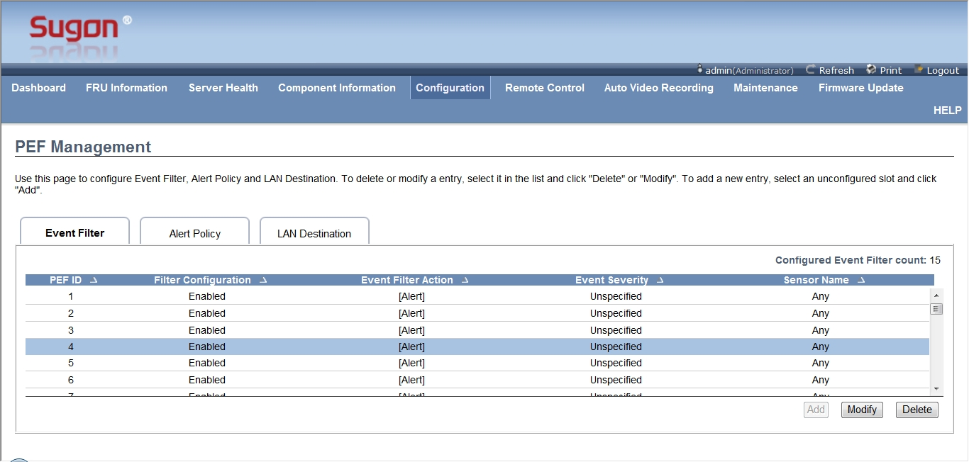
Powerful IPMI monitoring function
Introduction of I980-G10 BMC PEF menu
Click it to change various labs
Event filter lists
Filter can be added, modified and deleted.
Notes:
先讲整个IT行业的大背景

Slide 58
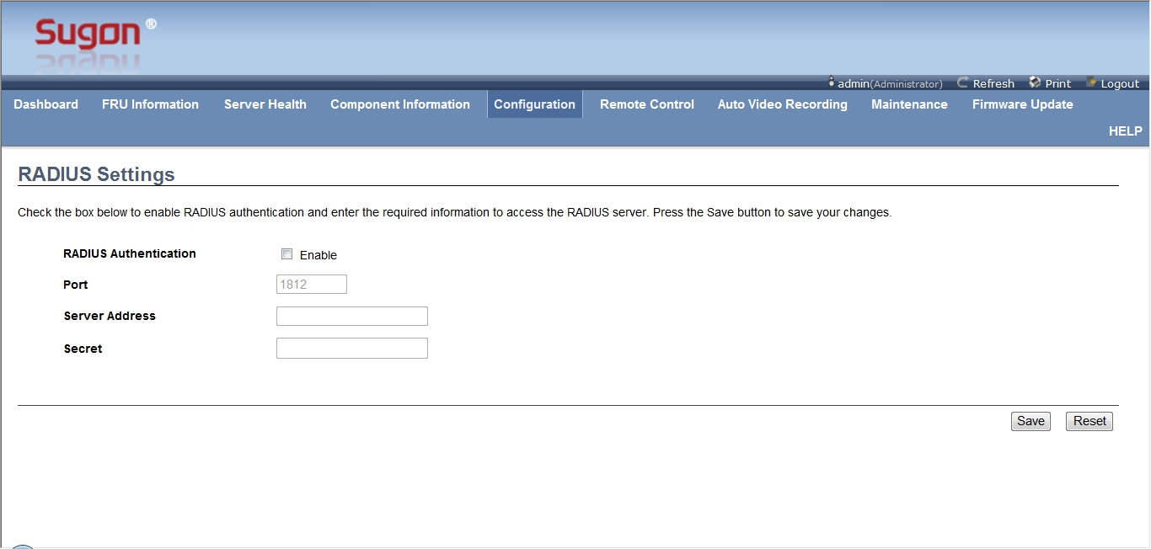
Powerful IPMI monitoring function
Introduction of I980-G10 BMC RADIUS menu
Selecting it starts RADIUS function
Set RADIUS function
Notes:
先讲整个IT行业的大背景

Slide 59
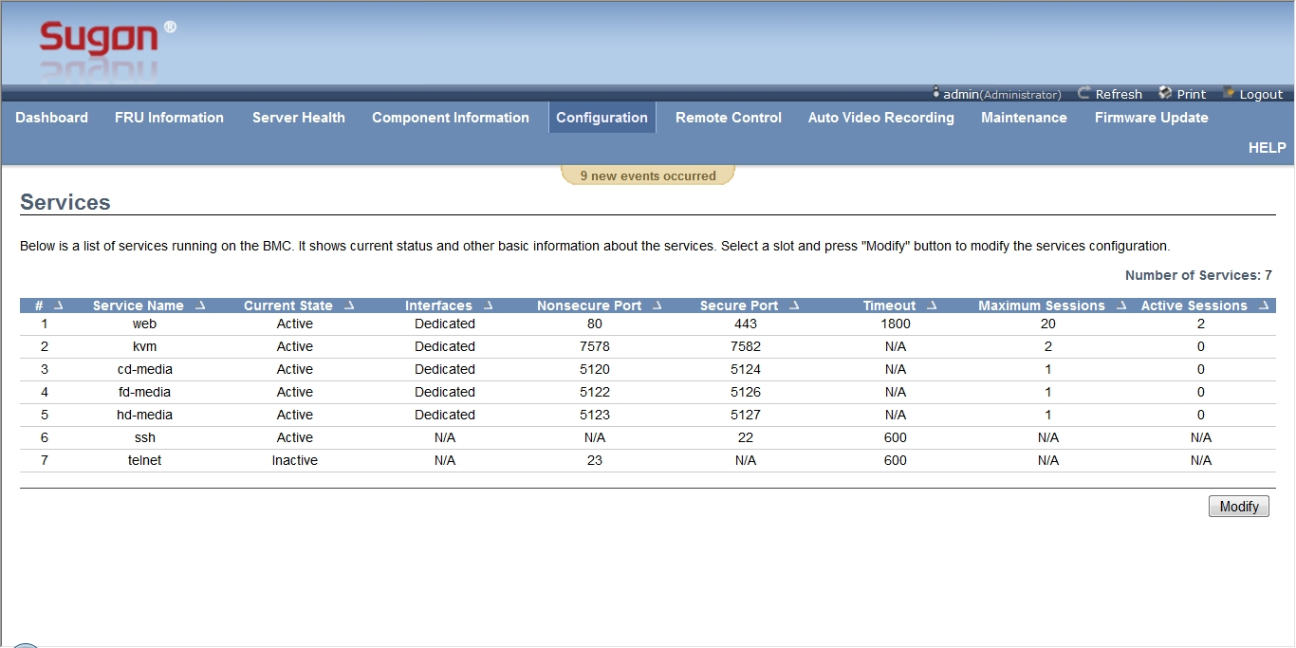
Powerful IPMI monitoring function
Introduction of I980-G10 BMC Services menu
BMC server lists
After selecting serve item, click here to modify it.
Notes:
先讲整个IT行业的大背景

Slide 60
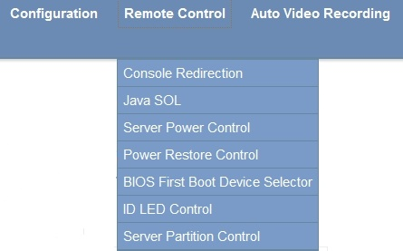
Powerful IPMI monitoring function
Introduction of I980-G10 BMC Remote Control submenu
Submenu | Function
Console Redirection | Start Java remote desktop
Java SOL | start Java remote serial-console
Server Power Control | Server remote power controlling
Power Restore Control | Set recovery actions after unexpected power failure
BIOS First Boot Device Selector | Set BIOS booting order
ID LED Control | ID light remote controlling
Server Partition Control | Set machine partition mode
Notes:
先讲整个IT行业的大背景

Slide 61
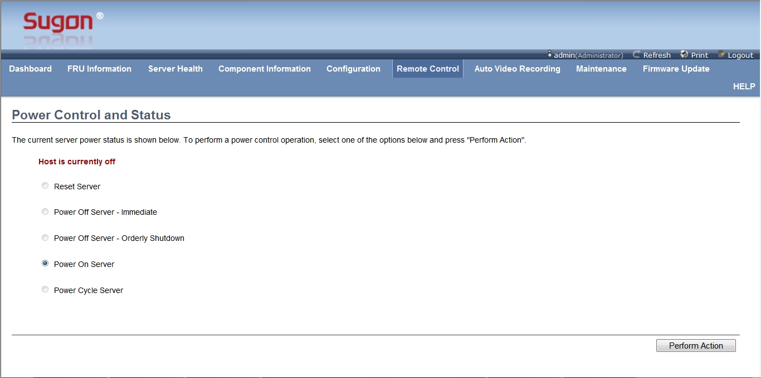
Powerful IPMI monitoring function
Introduction of I980-G10 BMC Server Power Control menu
The machine is in booting state.
Remote controlling items
Click it to complete all the selected actions
Notes:
先讲整个IT行业的大背景

Slide 62
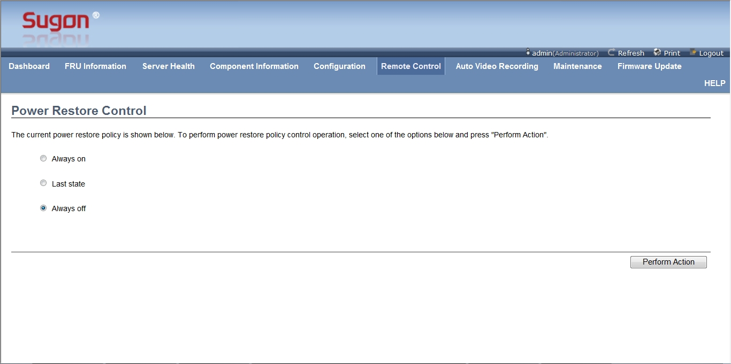
Powerful IPMI monitoring function
Introduction of I980-G10 BMC Power Restore Control menu
Setting items of recovery actions after unexpected power failure
Click it to make the setting effective
Notes:
先讲整个IT行业的大背景

Slide 63
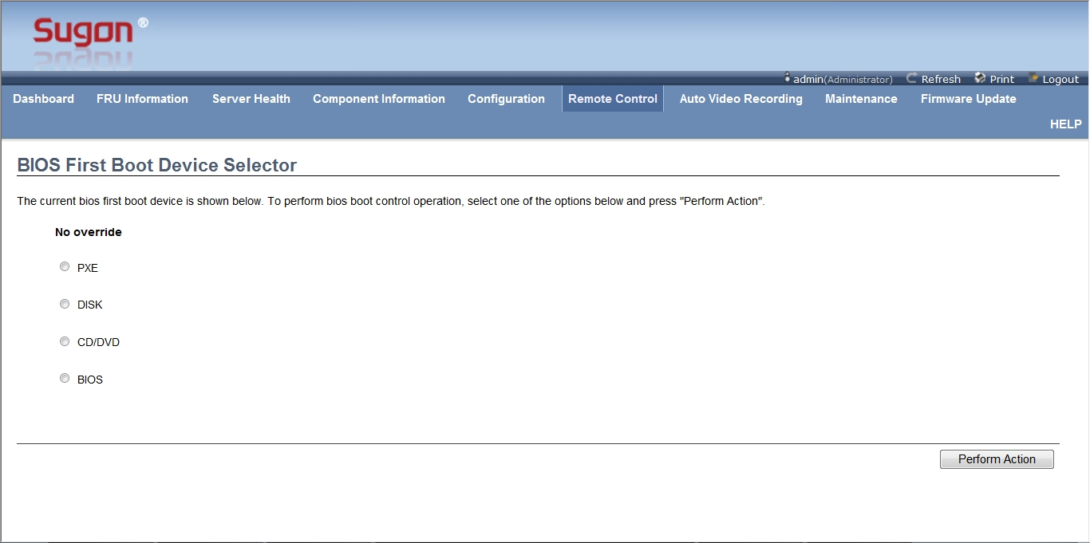
Powerful IPMI monitoring function
Introduction of I980-G10 BMC BIOS First Boot Device Selector menu
BIOS first boot device items
Click it to make the setting effective
Notes:
先讲整个IT行业的大背景

Slide 64
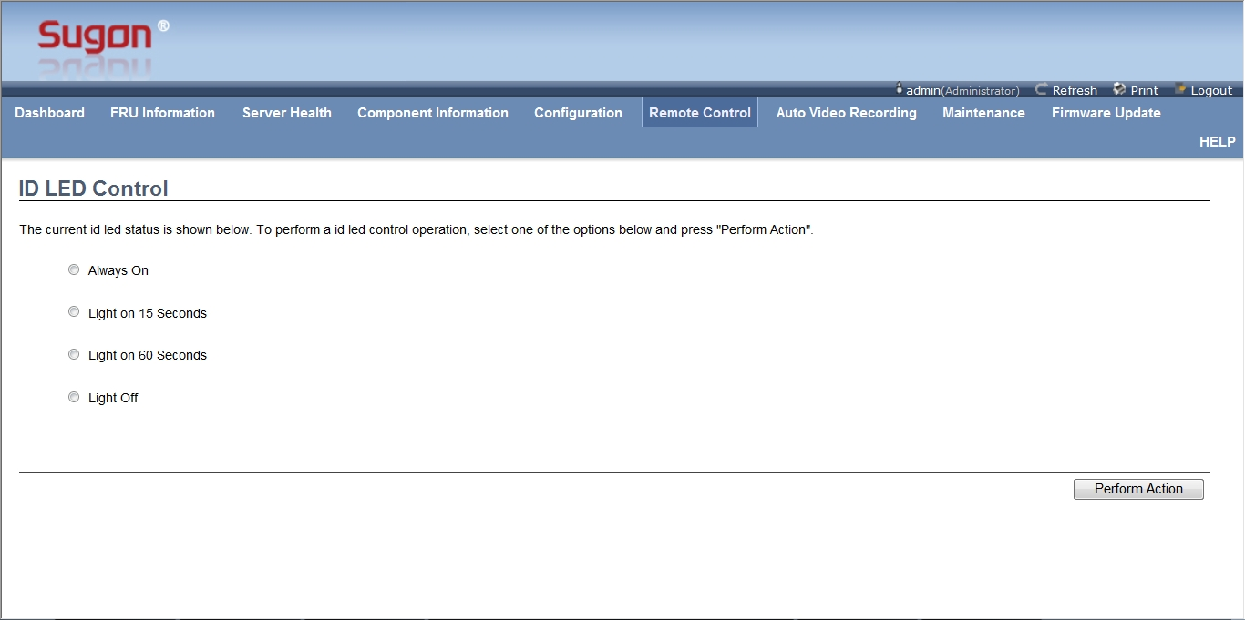
Powerful IPMI monitoring function
Introduction of I980-G10 BMC ID LED Control menu
ID LED action setting items
Click it to make the setting effective
Notes:
先讲整个IT行业的大背景

Slide 65
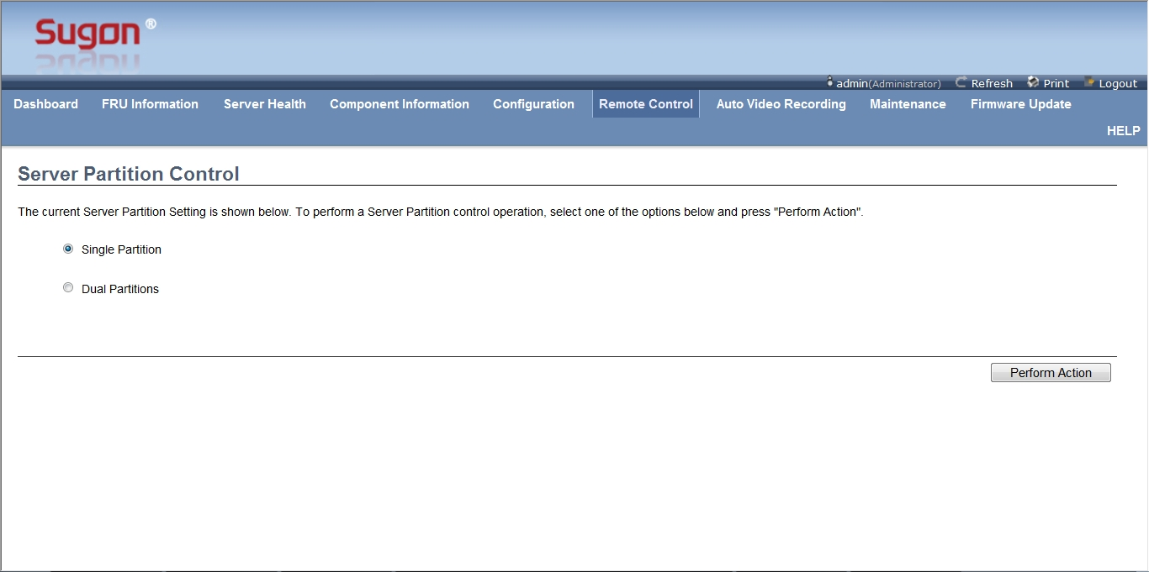
Powerful IPMI monitoring function
Introduction of I980-G10 BMC Server Partition Control menu
Partitioning set items
Click it to make the setting effective
Notes:
先讲整个IT行业的大背景

Slide 66
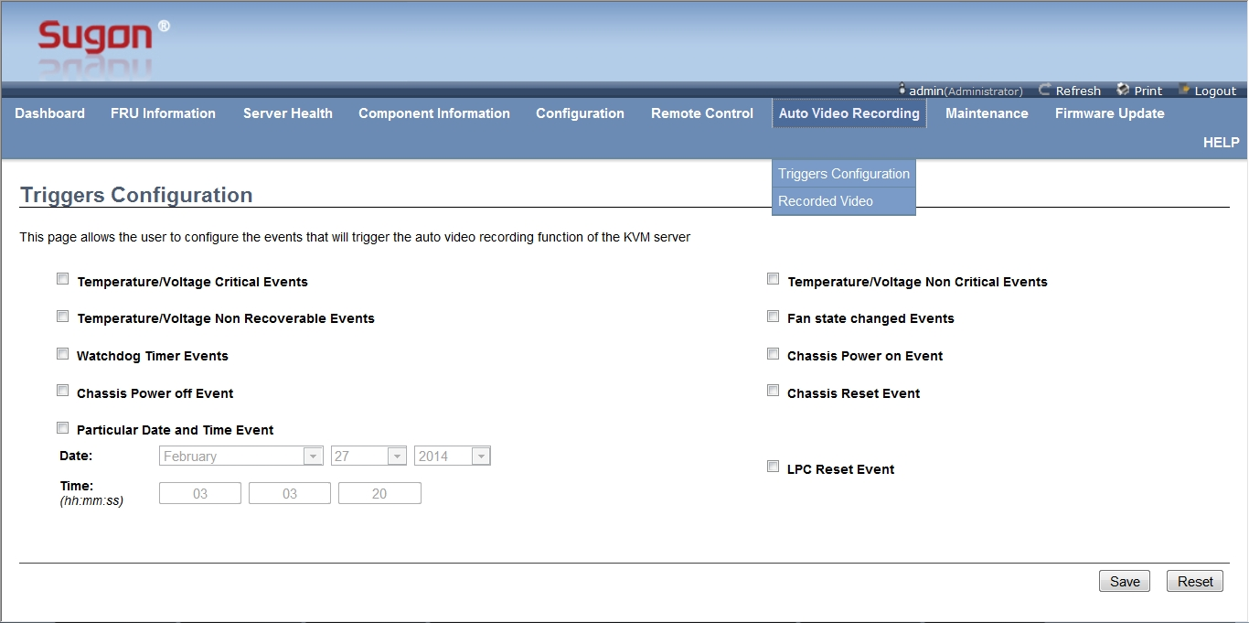
Powerful IPMI monitoring function
Introduction of I980-G10 BMC Auto Video Recording menu
Set triggers, and after meeting needs it can automatically record videos
This menu showing lists of recorded videos and they can be played, downloaded and deleted.
Optional triggers
Notes:
先讲整个IT行业的大背景

Slide 67
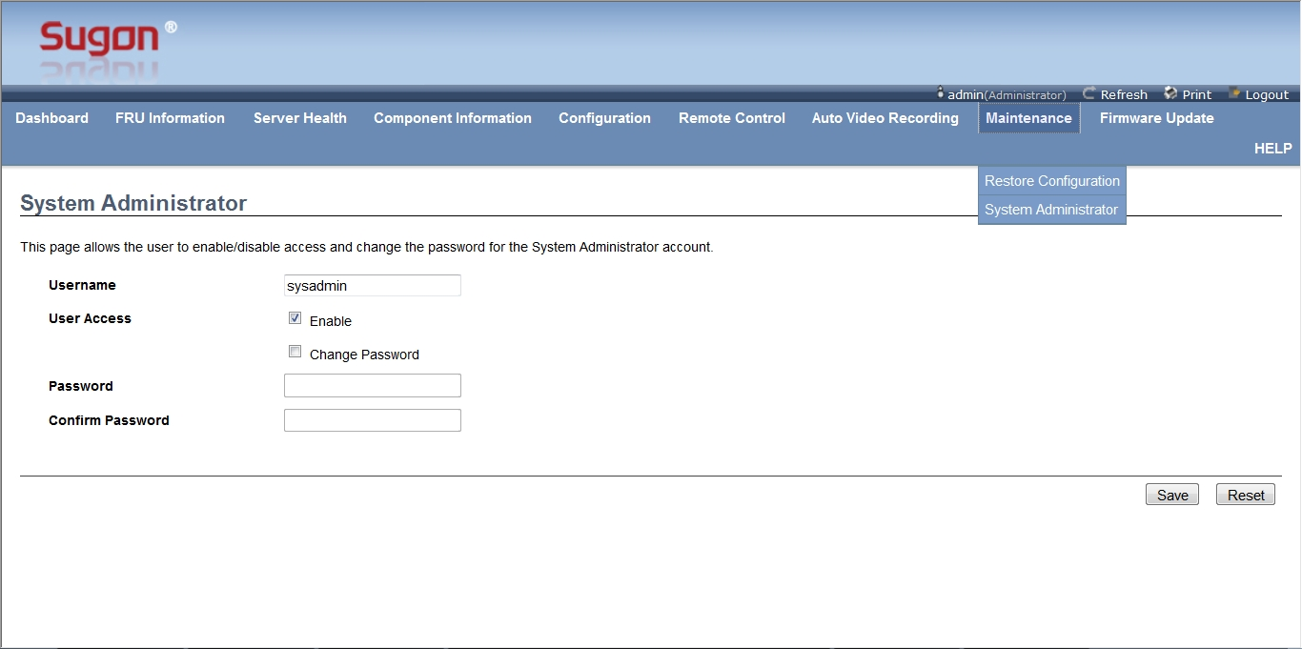
Powerful IPMI monitoring function
Introduction of I980-G10 BMC Maintenance menu
This menu can reset BMC and then restart BMC
Allow/forbid sysadmin login and changing sysadmin password
Sysadmin superuser is for run and debug and can login through SSH
Deselecting it will ban sysadmin login
Selecting it can renew sysadmin password
Notes:
先讲整个IT行业的大背景

Slide 68
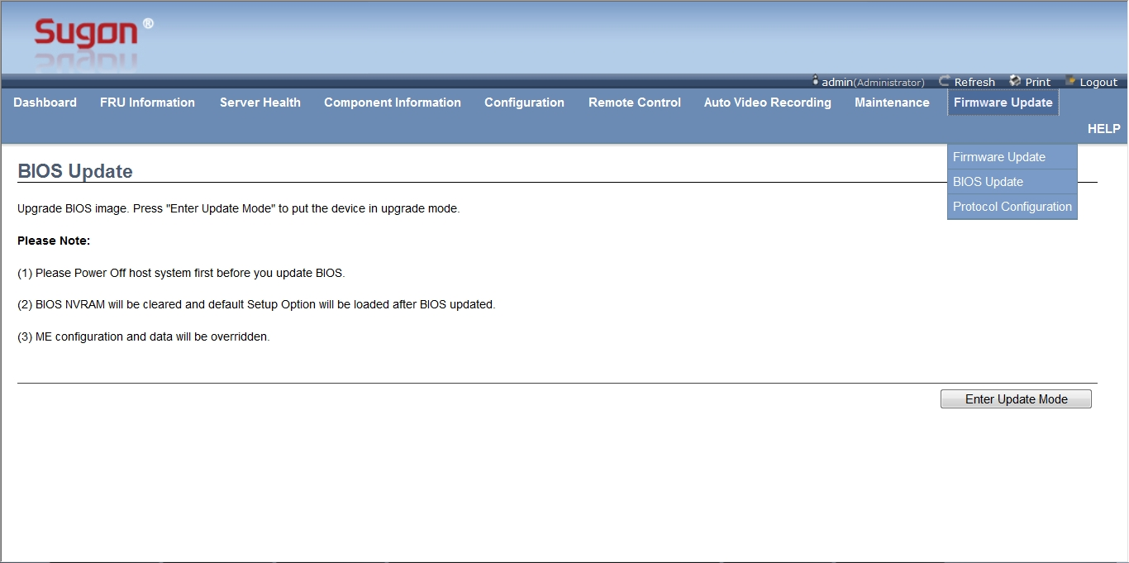
Powerful IPMI monitoring function
Introduction of I980-G10 BMC BIOS Update menu
Update BMC Firmware
Update BIOS Firmware
Set Firmware transport protocol
Description and attention
Click it and enter BIOS FW update mode according to operating description
Notes:
先讲整个IT行业的大背景

Slide 69

Powerful IPMI monitoring function
Introduction of I980-G10 BMC Firmware Update menu
Tips of firmware file transport protocol
Select it to save original BMC setting
Click it and enter BMC FW update mode according to operating description
Notes:
先讲整个IT行业的大背景

Slide 70

Powerful IPMI monitoring function
I980-G10 BMC Protocol Configuration菜单介绍
HTTP/HTTPs protocol can find FW file through local browser;
TFTP protocol can find FW file through server.
Notes:
先讲整个IT行业的大背景

Slide 71

Powerful touching LCD monitoring screen
screen size：4.3 inch
Tangible
Friendly interface
Convenient operation
Powerful functions：
1.Check information as machine configuration, serial number and BIOS edition.
2.Monitor healthy state of every module.
3.Show machine power consumption state.
4.Check logs.
5.Foudational setting functions such as BMC IP,account, password and partitioning setting.
Notes:
先讲整个IT行业的大背景

Slide 72
Powerful touching LCD monitoring screen
I980-G10 introduction of monitoring screen sidebar
sidebar
Click the white triangle to open/close sidebar
Notes:
先讲整个IT行业的大背景

Slide 73

Powerful touching LCD monitoring screen
I980-G10 introduction of monitoring screen main interface
State of such modules as monitoring mainboard, hard disk, power, fan, IOE, 10-gigabit, management board. Abnormal module turning red, click it to enter detailed information interface.
Device information
Power consumption information
Notes:
先讲整个IT行业的大背景

Slide 74

Powerful touching LCD monitoring screen
I980-G10 parts of monitoring screen –mainboard introduction
It can monitor state of CPU and memory. The abnormal module turns red and click it to enter detailed information interface.
Monitoring parts --Secondary Menu
Notes:
先讲整个IT行业的大背景

Slide 75

Powerful touching LCD monitoring screen
I980-G10 parts of monitoring screen –mainboard introduction
CPU detailed information interface
Notes:
先讲整个IT行业的大背景

Slide 76

Powerful touching LCD monitoring screen
I980-G10 parts of monitoring screen –mainboard introduction
Detailed memory information interface
Notes:
先讲整个IT行业的大背景

Slide 77

Powerful touching LCD monitoring screen
I980-G10 parts of monitoring screen –hard disk introduction
It can monitor all the hard disk state. The abnormal module turns red and click it to enter detailed information interface.
Notes:
先讲整个IT行业的大背景

Slide 78

Powerful touching LCD monitoring screen
I980-G10 parts of monitoring screen –hard disk introduction
Detailed hard disk information interface
Notes:
先讲整个IT行业的大背景

Slide 79

Powerful touching LCD monitoring screen
I980-G10 parts of monitoring screen –fan introduction
It can monitor all the fan state. The abnormal module turns red and click it to enter detailed information interface.
Notes:
先讲整个IT行业的大背景

Slide 80

Powerful touching LCD monitoring screen
I980-G10 parts of monitoring screen –fan introduction
Detailed fan information interface
Notes:
先讲整个IT行业的大背景

Slide 81

Powerful touching LCD monitoring screen
I980-G10 parts of monitoring screen –power introduction
It can monitor all the power state. The abnormal module turns red and click it to enter detailed information interface.
Notes:
先讲整个IT行业的大背景

Slide 82

Powerful touching LCD monitoring screen
I980-G10 parts of monitoring screen –power introduction
Detailed power information interface
Notes:
先讲整个IT行业的大背景

Slide 83

Powerful touching LCD monitoring screen
I980-G10 parts of monitoring screen –PCIe introduction
It can monitor all IOE, RAID card and 10-gigabit modules state. The abnormal module turns red and click it to enter detailed information interface.
Notes:
先讲整个IT行业的大背景

Slide 84

Powerful touching LCD monitoring screen
I980-G10 parts of monitoring screen –PCIe introduction
PCIe detailed information interface
Notes:
先讲整个IT行业的大背景

Slide 85

Powerful touching LCD monitoring screen
Powerful touching LCD monitoring screen
I980-G10 parts of monitoring screen –MM introduction
It can monitor all the management modules state. The abnormal module turns red and click it to enter detailed information interface.
Notes:
先讲整个IT行业的大背景

Slide 86

Powerful touching LCD monitoring screen
Powerful touching LCD monitoring screen
I980-G10 parts of monitoring screen –MM introduction
Information interface of port IP address in management module
Notes:
先讲整个IT行业的大背景

Slide 87

Powerful touching LCD monitoring screen
Powerful touching LCD monitoring screen
I980-G10 parts of monitoring screen – switch introduction
System setting needs login;username and password,the same with username and password of BMC, are admin/admin.
Click the needed setting page
Partition 1
Setting area
Choose corresponding operation and click save key.
Partition 2 setting area
When it is single part, this place is empty.
Notes:
先讲整个IT行业的大背景

Slide 88

Powerful touching LCD monitoring screen
Powerful touching LCD monitoring screen
I980-G10 监控屏系统设置 –分区模式设置介绍
I980-G10 parts of monitoring screen – introduction of partitioning mode setting
Current partitioning mode
Choose corresponding operation and click save key.
Set partitioning mode
Notes:
先讲整个IT行业的大背景

Slide 89

Powerful touching LCD monitoring screen
Powerful touching LCD monitoring screen
I980-G10 parts of monitoring screen – introduction of BMC IP setting
Chose the port need to be set
Choose corresponding operation and click save key.
Set the port
Notes:
先讲整个IT行业的大背景

Slide 90

Powerful touching LCD monitoring screen
Powerful touching LCD monitoring screen
I980-G10 parts of monitoring screen –introduction of system log
Select log according to time
Select log according to module
Click it to delete chose log
Click it to choose single log
Notes:
先讲整个IT行业的大背景

Slide 91

Powerful touching LCD monitoring screen
Powerful touching LCD monitoring screen
I980-G10 parts of monitoring screen –introduction of system log
Click it to enter corresponding information interface.
Server information
Notes:
先讲整个IT行业的大背景

Slide 92

Powerful touching LCD monitoring screen
Powerful touching LCD monitoring screen
I980-G10 parts of monitoring screen –introduction of system log
Network information
Notes:
先讲整个IT行业的大背景

Slide 93

Powerful touching LCD monitoring screen
Powerful touching LCD monitoring screen
I980-G10 parts of monitoring screen –MM introduction
Company introduction
Notes:
先讲整个IT行业的大背景

Slide 94
Contents
1
An overview of I980-G10 server
2
Introduce every module of I980-G10 server
3
Introduce management module of I980-G10 server
4
Structure and installation of I980-G10 server
Notes:
先讲整个IT行业的大背景

Slide 95


I980-G10 description of module plug method
1, In CPU board, IOE module and 10-gigabit module, first to press lock catch, open locking lever and then pull it out；
2, hard disk, fan and power module all have blue lock catch; then press it.
3, before taking out management module, take out fan module beside, then open lock catch of management module, and take out management module.
Notes:
先讲整个IT行业的大背景

Slide 96


Dismounting management module
1, open top cover：as the right picture shows，press lock catch, push it out.
2、Push Card: a little card in management module. As the left picture shows, the small card has switch button and ID button.
Notes:
先讲整个IT行业的大背景

Slide 97


Dismounting 10-gigabit module
1、open top cover：as the right picture shows，press lock catch in red cross, push it out.
2、installing led cob:as the left picture shows，install three led cobs.
3、installing order：when installing only one 10-gigabit module, use in preference to slot1.
Notes:
先讲整个IT行业的大背景

Slide 98


Dismounting computing module
1, before installing computing module, the hot-plug button on computing module should be installed first, as shown in right picture.
2, put hardy holes into mushroom columns, flat push to make mushroom column stuck at hardy holes, and finally tighten up four screws.
Notes:
先讲整个IT行业的大背景

Slide 99




Dismounting inner chassis
1,description：when installing panel and fan board,remove the inner chassis first
2,screw location：6 on the back of machine, 3 on the top, 3 on each two side，as shown in pictures above. Unscrewing these screws, inner chassis can be taken out.
3, two fragments on two sides：when taking out half of inner chassis, it will be stuck and two fragments being pressed will help take it out, as shown in the right picture.
hole
4、hole design: there are holes inside and in both sides of inner chassis, as shown in the right picture. They are convenient for taking inner chassis.
fragment
Notes:
先讲整个IT行业的大背景

Slide 100

Dismounting back panel of fan module
1,attention: before install back panel of fan, remove crossband.
hardy hole
2、back panel installation: back panel of fan is installed in front two sides of inner chassis, as shown in the picture: put back hardy holes into mushroom columns, flat push to make mushroom column stuck at hardy holes, and finally tighten up the only one screw.
screw
hardy hole
Notes:
先讲整个IT行业的大背景

Slide 101

Dismounting crossband
1、attention: before installing crossband, install the back panel of fan first.
stud
stud
stud
stud
2、crossband installation: crossband is installed in the front of inner chassis, as shown in the picture. Put studs into round holes of crossband to make crossband close to inner chassis and finally tighten up 16 screws.
stud
stud
Notes:
先讲整个IT行业的大背景

Slide 102

Dismounting memory module and front panel
1, as shown in the picture above, unscrew the screws in the memory module and both sides of front panel, and then take out memory module and front panel.
Notes:
先讲整个IT行业的大背景

Slide 103


Dismounting monitoring screen
1，open monitoring screen: pull recess on the side of monitor screen outside.Then you can open monitoring screen and see interface, drive and tape inside.
recess
2, install monitoring screen: unscrew 2 screws in storage module and side of front panel, and the monitoring screen will be pulled out.
Notes:
先讲整个IT行业的大背景

Slide 104



Dismounting front panel and drive
1, Remove the bracket：unscrew 2 screws in storage module and side of front panel, and front panel and drive bracket can be pulled out, as shown in the picture below.
2、install drive: unscrew 2 screws in the side of bracket, and drive can be pulled out, as shown in the picture above.
Slide design is for less screws and convenient to install.
3、install front panel: unscrew 4 screws, and front panel can be pulled out, as shown in the right picture.
Notes:
先讲整个IT行业的大背景

Slide 105


Dismounting tape machine
1,notice：first remove front panel and drive and then remove tape machine.
2,press lock catches in storage and the side of front panel, and the tape machine can be pulled out, as shown in the right picture.
3、side dam ：a dam on the side of tape machine, and only when it is installed, tape machine can be put into inner chassis.
Notes:
先讲整个IT行业的大背景

Slide 106

Dismounting monitoring board
1, install monitoring board: as shown in the picture, monitoring board installed between storage and front panel, and then put it on the right place, screwing screws.
Notes:
先讲整个IT行业的大背景

Slide 107



Dismounting Riser card and RAID card
1, install Riser card：as shown in the right picture, unscrewing 4 screws in storage and the back of front panel help s remove Riser card bracket; put Riser card into bracket, and screw screws.
2, install RAID card：as shown in the left picture, open lock catch on bracket; change RAID card into short dam and put it into Riser card slot.
It belongs to CPU4
3, notice：2 PCIe slots in Riser card: one belongs to CPU0 and the other belongs to CPU4；when install RAID card, use in preference to the slot of CPU0;when two machines are 4-way, two PCI-Es belong to different machine.
It belongs to CPU0
Notes:
先讲整个IT行业的大背景

Slide 108

Dismounting RAID card and cooling fan
1, install RAID card and cooling fan: fan installed in two studs of storage and front panel, put two long studs into two holes in the fan, and finally screw 2 screws.
Notes:
先讲整个IT行业的大背景

Slide 109


Dismounting RAID card battery/capacitance
1, installing location: there are 2 RAID card battery/capacitance installing places in wire slots of storage and front panel, as show in the right picture.
Mushroom column in which slide goes.
Put and firm two brackets together
2, bracket description: 2 brackets in RAID card battery/capacitance: one is as accessory with battery/capacitance and the other is installed in chassis. First removing rackets in chassis, put them together with the bracket of accessory using screws, as shown in the left picture.
3, hold bracket：put the combined bracket into chassis(there is side like drive bracket in the bottom of bracket) and screw the only screw.
4, put battery/capacitance into bracket.
Notes:
先讲整个IT行业的大背景

Slide 110


Dismounting extended battery card of RAID card
1, description：when 9270/9271 RAID card installing battery, it needs install another PCB board；the PCB board provides interface linking the battery.
2、install extended battery card of RAID card ：put the interface of extended card with the interface of RAID card，and screw 3 back screws, as shown in the picture below.
Notes:
先讲整个IT行业的大背景

Slide 111

Introduction of cables on monitoring board
1, interface of front panel: connected with front panel (providing mini-board of 1 VGA and 2 USB interface)
Interface of front interface
Interface of monitoring screen
2, interface of monitoring screen: connected with monitoring screen.
SATA interface
3, power interface: through a 1-4 cable(3700 0370) proving power for back board of hard disk and drive.
I2C interface
4, SATA interface：connected with interface of drive data
Power interface
5, I2C interface：connected with I2C interface in back board of hard disk.
Notes:
先讲整个IT行业的大背景

Slide 112


Description of linking wire
1, I2C interface in the back of hard dis, as shown in the right picture.
Drive interface
power interface of hard disk back
MiniSAS interface
2,drive interface,MiniSAS interface, and the interface in the back of hard disk, as shown in the left picture.
3、make cables in cooling fan of RAID card connect with fan interface of Riser card.
Notes:
先讲整个IT行业的大背景

Slide 113

Description of cable link
4,Description of cable link in monitoring screen: as shown in the picture above, pull out two lock catches of cable interface ports. Put the silver up into holes, and then put back the black button.
Notes:
先讲整个IT行业的大背景

